Slide 1
GPU Computing with CUDA
Objectives
How to write and run a CUDA program for GPU computing
How to profile and tune the performance of a CUDA program
How to use libraries to accelerate the CUDA program development
Prerequisites
You (probably) need experience with C or C++
You don’t need experience with parallel programming, GPU computing, or graphics processing
Topics
Overview of GPU computing
CUDA basics
CUDA optimization
CUDA libraries

Slide 2
GPU Computing with CUDA
References and resources:
J. Cheng, M. Grossman, T. McKercher. Professional CUDA C Programming. Wrox Press Ltd, 2014
This part be finalized after we finalize the whole slides

Slide 3
Topics
GPU computing overview
CUDA programming basics
CUDA optimization
CUDA libraries
What and Why GPUs?
GPU architectures
From hardware to software: CUDA-enabled GPU execution mode
Installing and running CUDA

Slide 4
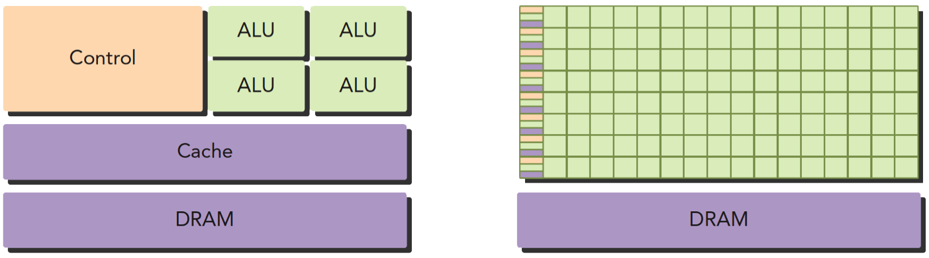
What and Why GPUs?
GPU (Graphics Processing Unit): hardware initially designed for graphics, and became more capable of general computations
Consists of multiprocessor element that run under the shared-memory threads model
CPU vs. GPU Hardware architecture Design Philosophies

Slide 5
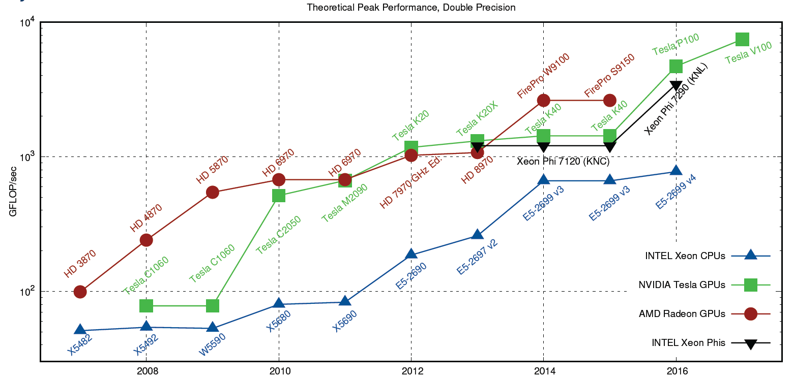
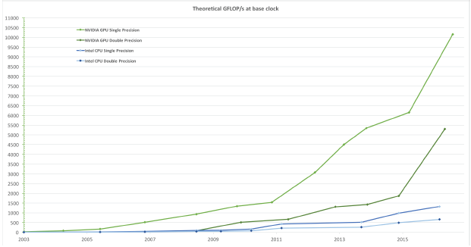
What and Why GPUs?
Far better peak performance than CPUs
Theoretical Peak Performance, Double Precision
Floating-Point Operations per Second for the CPU and GPU
PRACE training course "GPU programming with CUDA" @ JSC April 2017
CUDA C Programming Guide

Slide 6
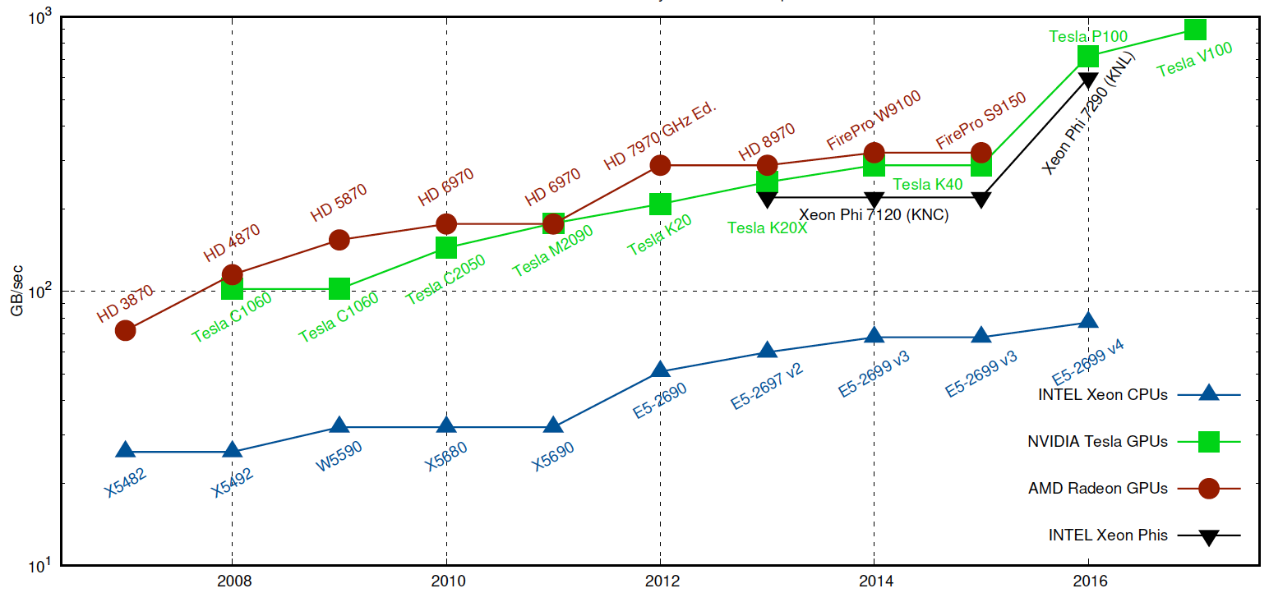
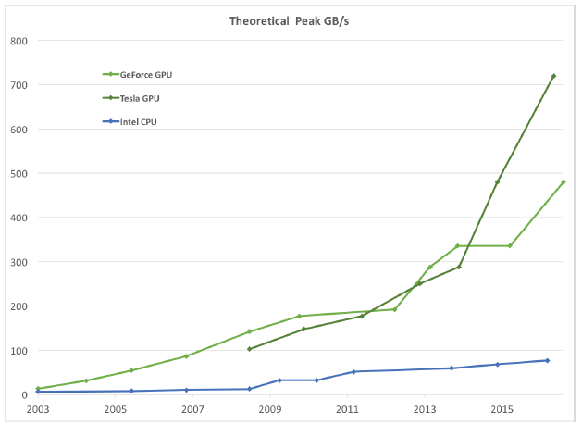
What and Why GPUs?
Fast processing along with high memory bandwidth
Theoretical Peak Memory Bandwidth Comparison
Memory Bandwidth for the CPU and GPU
PRACE training course "GPU programming with CUDA" @ JSC April 2017
CUDA C Programming Guide

Slide 7


What and Why GPUs?
Broadly used in scientific research and industrial applications
CUDA C Programming Guide

Slide 8
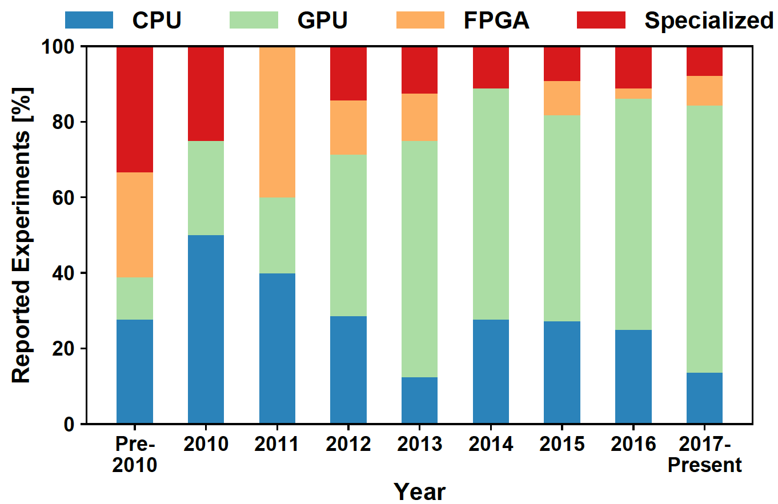
What and Why GPUs?
GPU computing for scientific applications
Parallel Architectures in Deep Learning
Tal Ben-Nun, Torsten Hoefler arXiv:1802.09941

Slide 9
GPU architectures
Brief history
Initially based on graphics focused fixed-function pipelines
First General-Purpose GPU (called “Tesla”) was released by NVIDIA in 2007. Five generations of hardware cards has been released released by NVIDIA till now.
Kepler: 1st released in 2012; excellent double precision(DP)
Maxwell: 1st released in 2014; architecture for gaming (so poor DP)
Pascal: 1st released in 2016; many gaming cards and several HPC cards
Volta: 1st released at end 2017; HPC cards with excellent DP
Turing: 1st released in Q3 2018; gaming version of Volta (so poor DP) and some HPC cards (specifically for AI inference)
Other GPUs: AMD; Intel; …

Slide 10

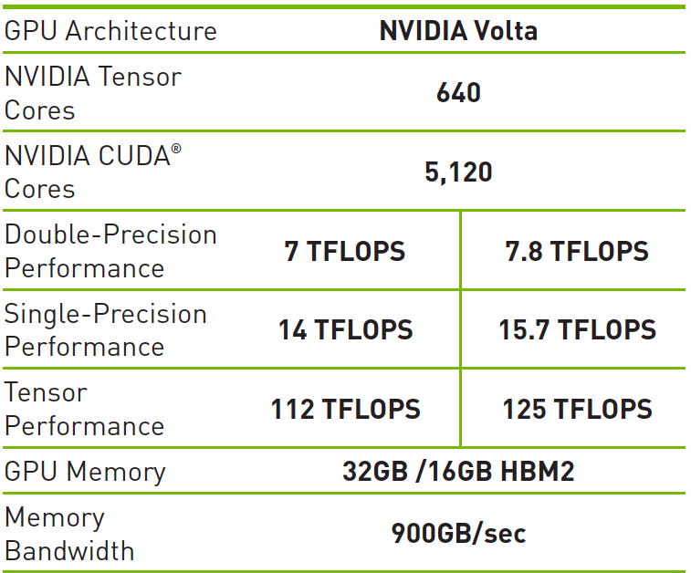
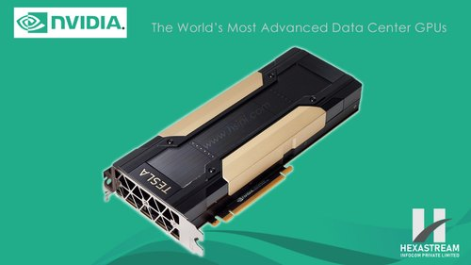
GPU architectures
NVIDIA GPUs in more details
Number of Nodes: 4,608
Node performance: 42 TF
Memory per Node: 512 GB DDR4 + 96 GB HBM2
NV memory per Node: 1600 GB
Processors:
2 IBM POWER9™ 9,216 CPUs
6 NVIDIA Volta( 27,648 GPUs)
Summit
NVIDIA Volta100 on Summit
Volta 100

Slide 11
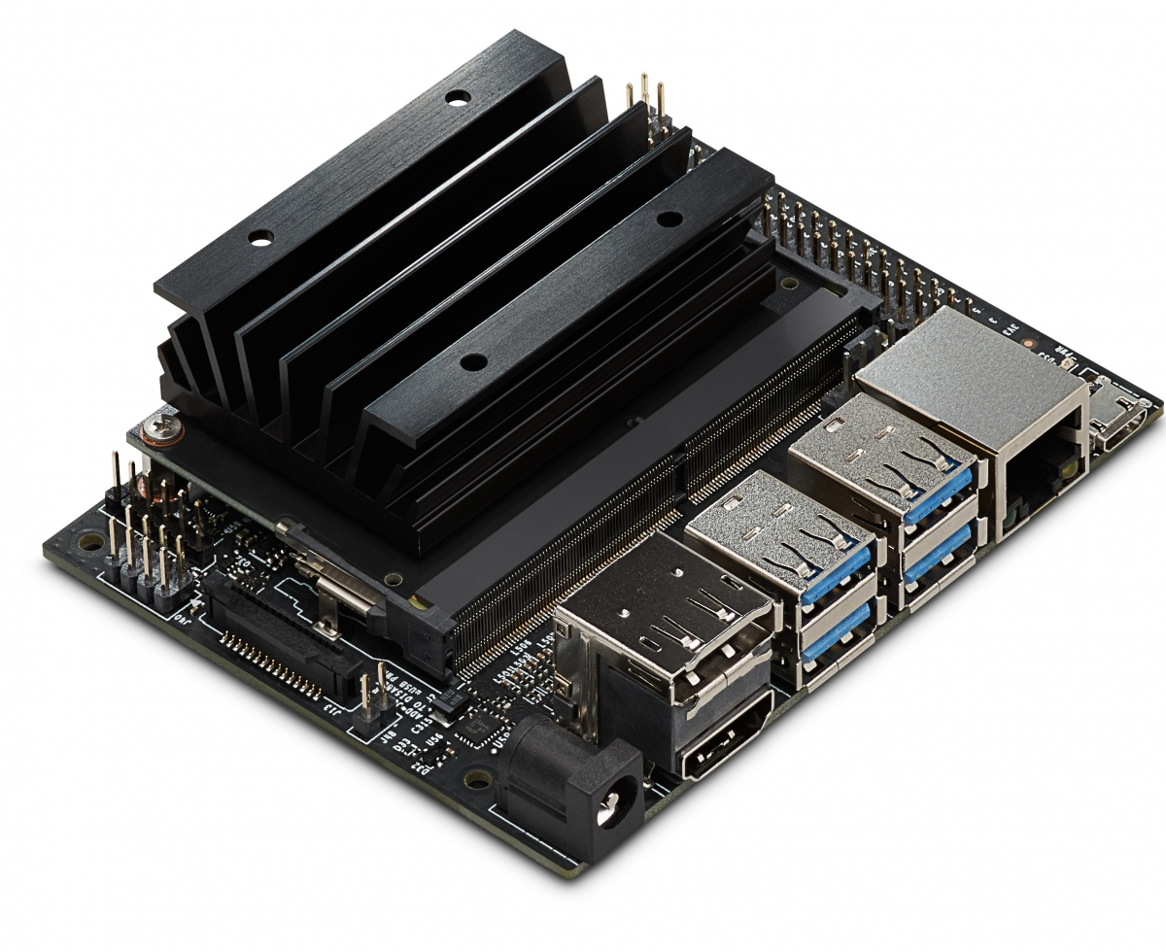
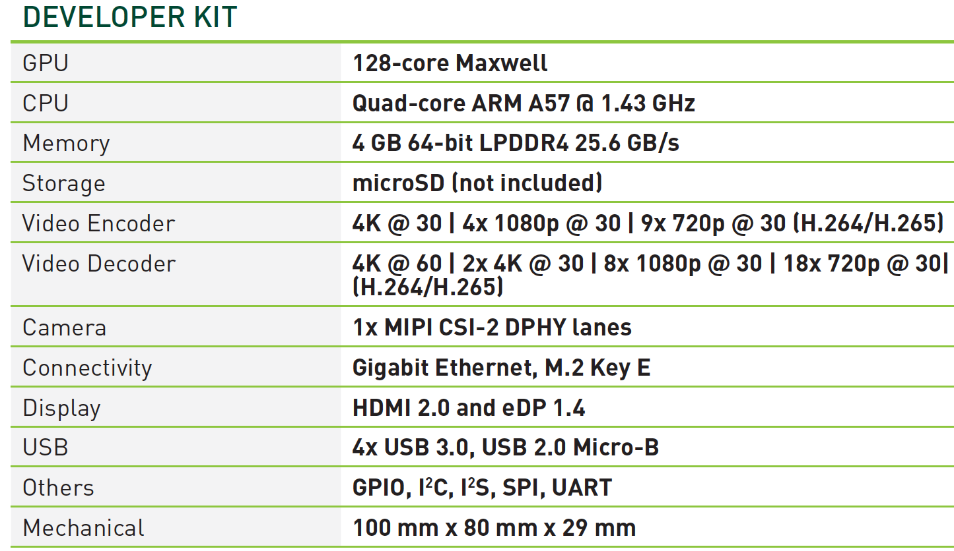
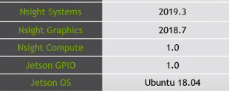
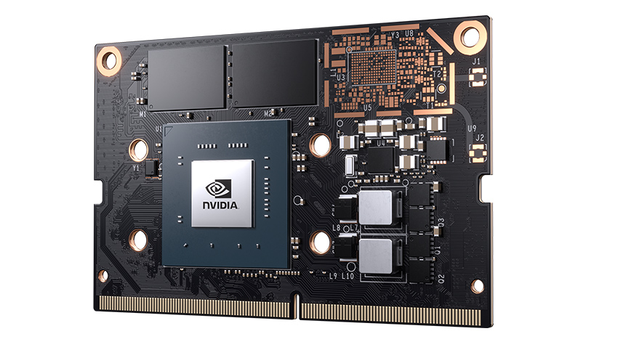
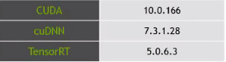
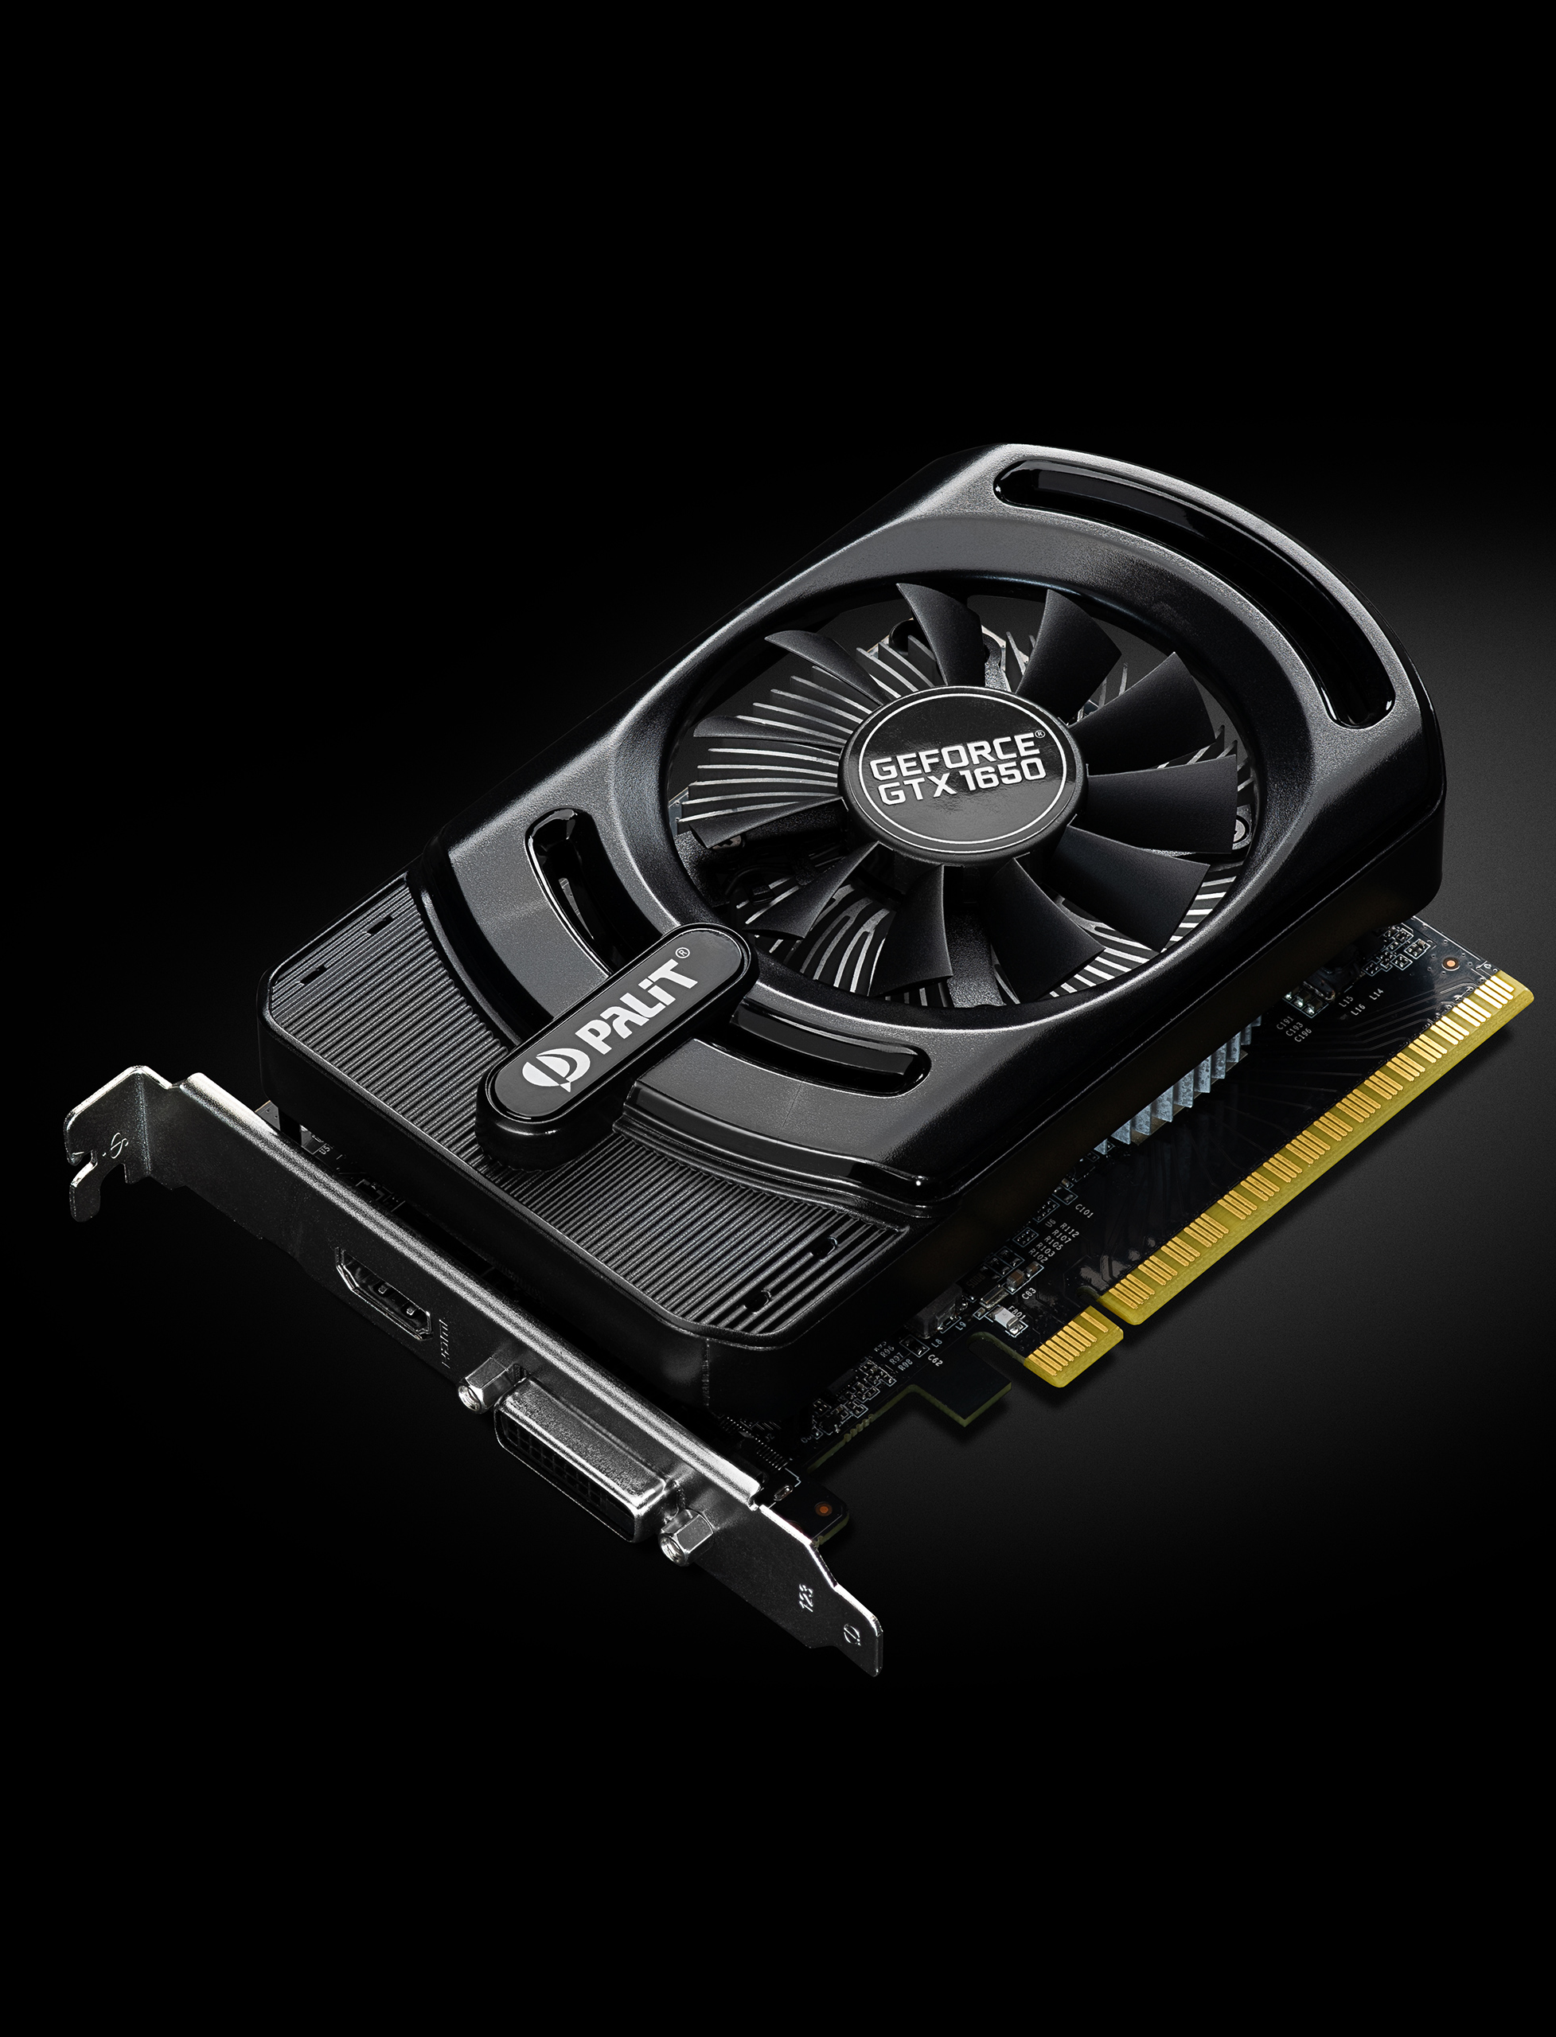
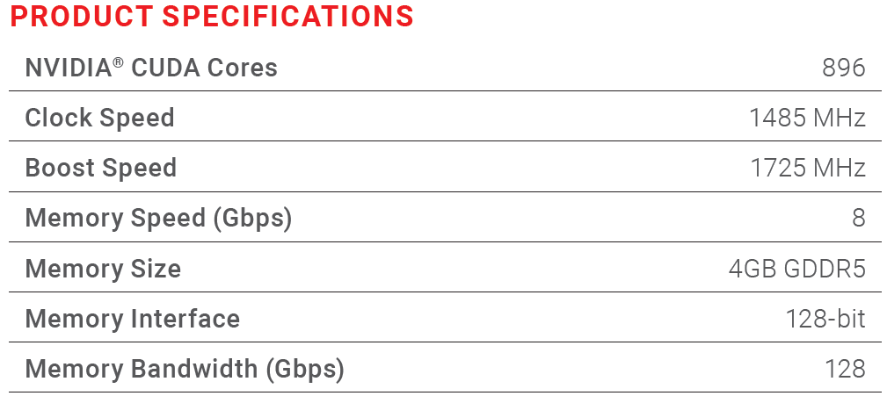
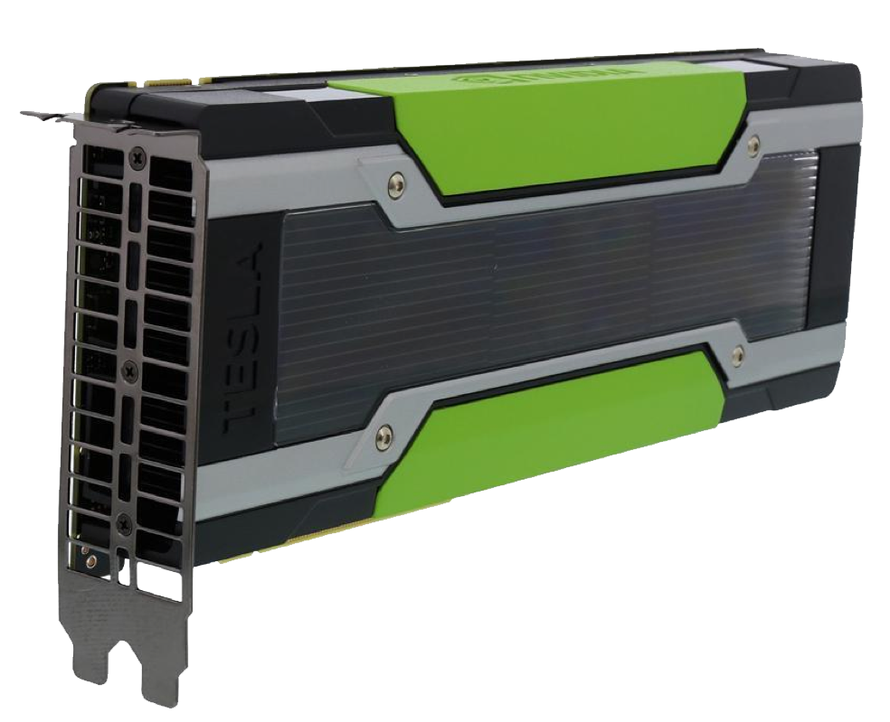
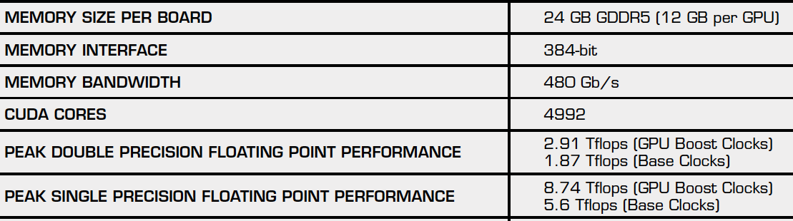
GPU architectures
NVIDIA GPUs in more details
Jetson Nano Developer Kit
Packages
Other NVIDIA GPUs used in this workshop: GTX 1650 , K80
NVIDIA Tesla K80
GTX 1650

Slide 12
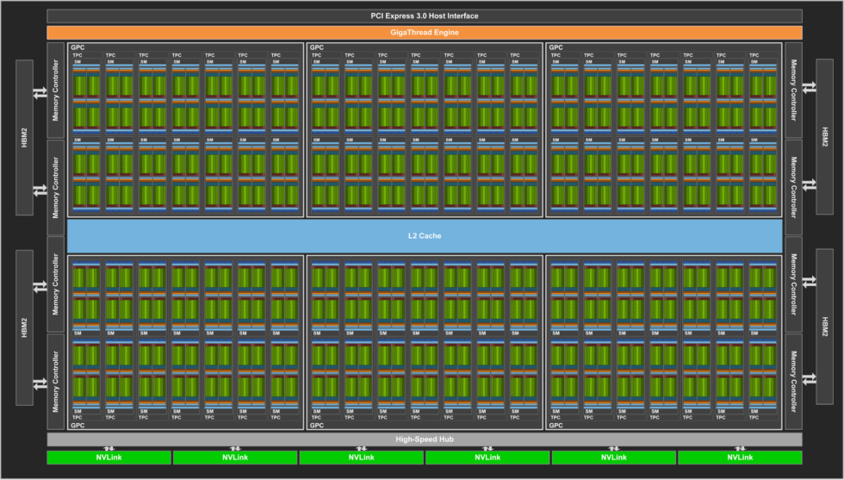
GPU architectures
NVIDIA GPU architectures (Volta100)
nvidia-tesla-v100-gpu-details
Streaming Multiprocessors (SMs)
32 cores
https://devblogs.nvidia.com/inside-volta/image3-3/

Slide 13
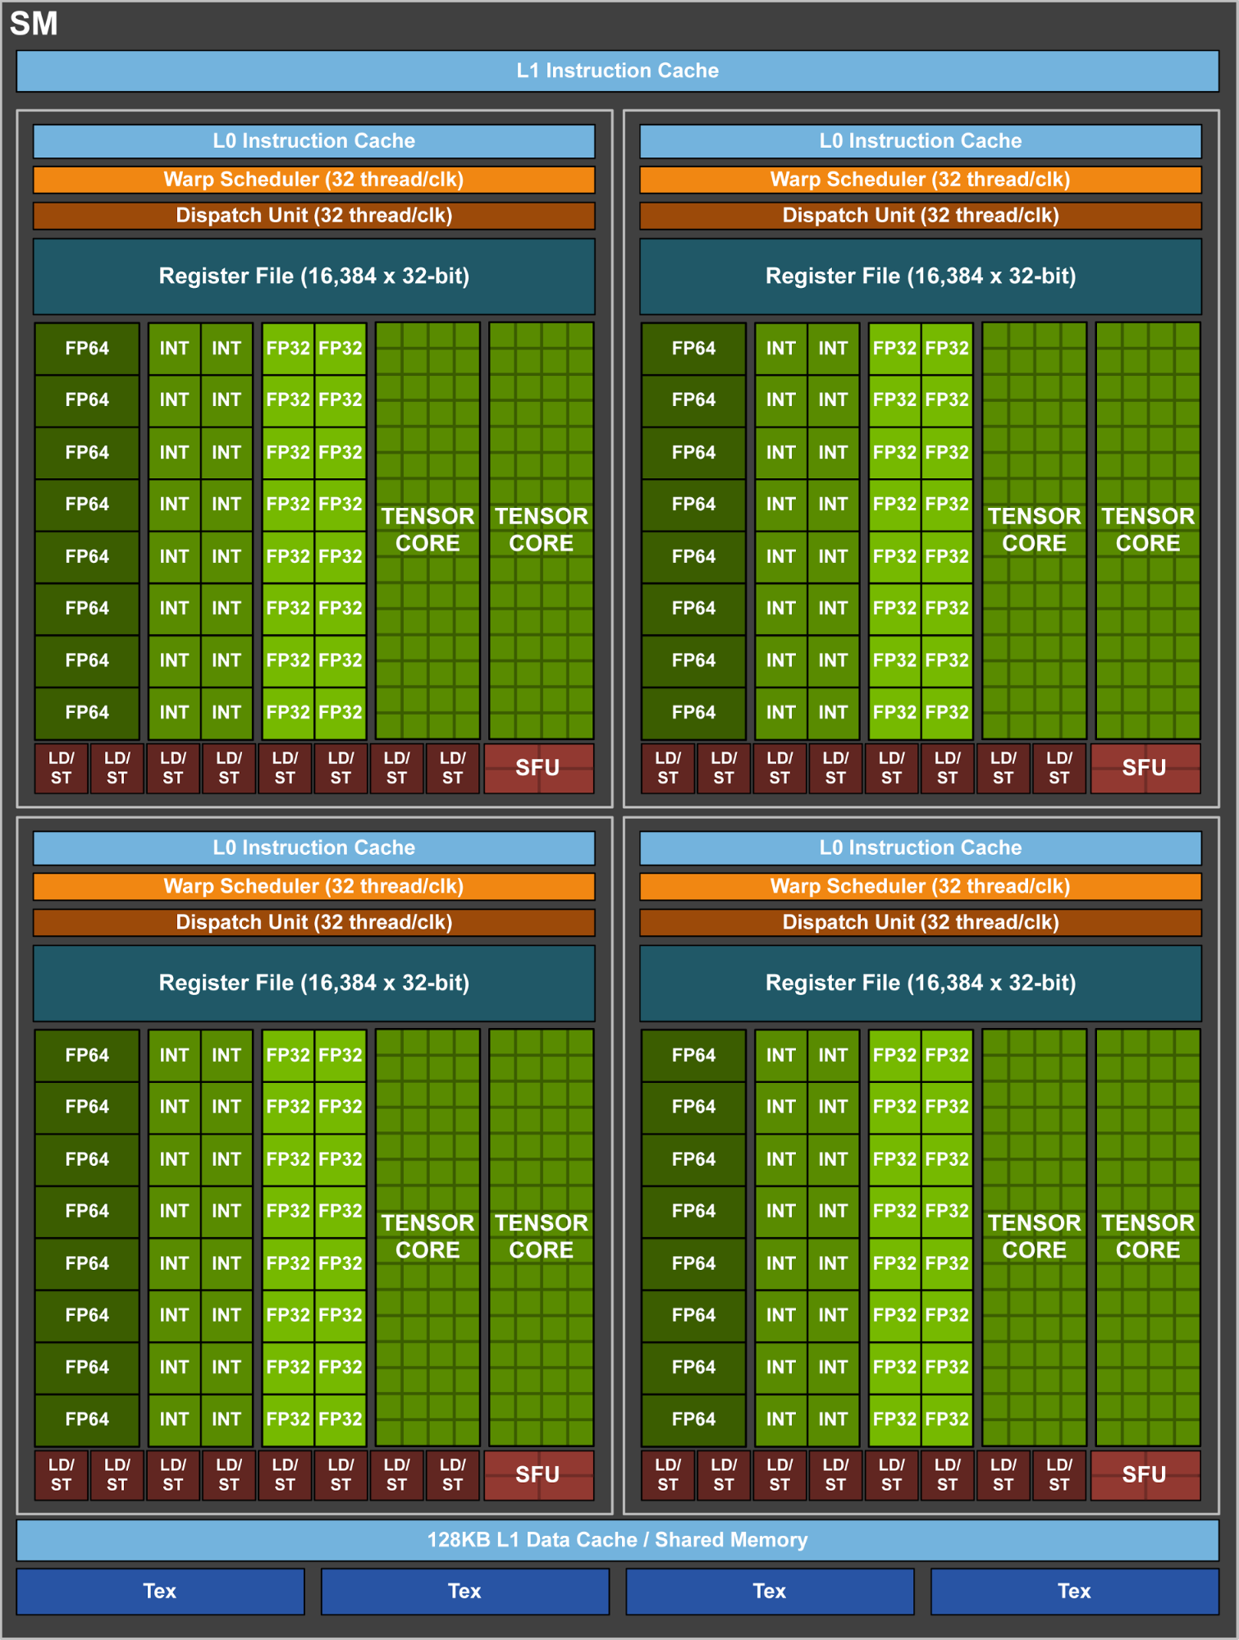
GPU architectures
Streaming Multiprocessors (SMs)
SM is the heart of the GPU architecture in which GPU uses as the basic building blocks.
Registers and shared memory are scarce resources in the SM.
In Volta 100, each SM is partitioned into four processing blocks, each with:
16 FP32 Cores;
8 FP64 Cores;
16 INT32 Cores;
128KB L1 / Shared memory;
64 KB Register File.

Slide 14
GPU architectures
SMs (cont’d)
SMs in Volta100
A FP32 core is the execution unit that performs single precision floating point arithmetic (floats).
A FP64 core performs double precision arithmetic (doubles).
A INT32 Core performs integer arithmetic.
The warp scheduler selects which warp (group of 32 threads) to send to which execution units (more to come).
64 KB Register File –lots of transistors used for vary fast memory.
128KB of configurable L1 (data) cache or shared memory
Shared memory is a used manged cache (more to come).
LD/ST units load and store data to/from cores.
SFU–special function units compute things like transcendentals.

Slide 15
GPU architectures
GPU capability and performance
Two important features that describe GPU capability:
Number of CUDA cores
Memory size
Two corresponding metrics for describing GPU performance:
Peak computational performance: how many single-precision or double-precision floating point calculations can be processed per second (e.g. trillion floating-point operations per second, tflops)
Memory bandwidth: the rate at which data can be read from or stored to memory (e.g. gigabytes per second, GB/s)
Product | #of Cuda Cores | DP (TFLOPS) | SP (TFLOPS) | Memory Size(GB) | memory Bandwidth(GB/s)
Jetson nano | 128 | n/a | 0.472 | 4 | 25.6
GTX1650 | 892 | n/a | 3.00 | 4 | 8.0
K80 | 4992 | 2.91 | 8.74 | 24 | 480.0
Volta 100 | 5120 | 7.00 | 14.00 | 32 | 900.0

Slide 16
Topics
GPU computing overview
CUDA programming basics
CUDA optimization
CUDA libraries
What and Why GPUs?
GPU architectures
From hardware to software: CUDA-enabled GPU execution mode
Installing and running CUDA

Slide 17
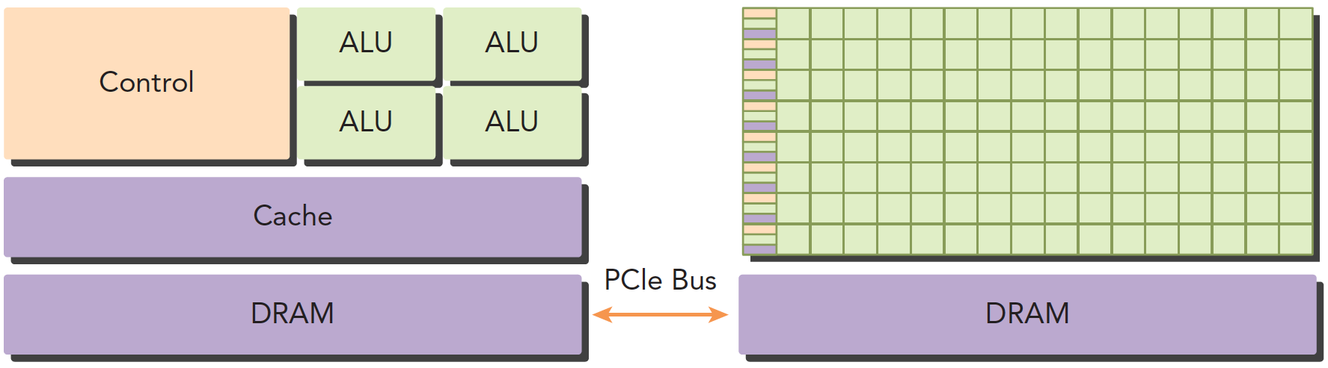
From hardware to software: GPU execution mode
GPU is not standalone but operates in conjunction with CPU
CPU (host)
GPU (device)
GPU execution platforms
NVIDIA: Compute Unified Device Architecture (CUDA)
AMD/ATI: StreamSDK/Brook+ (C/C++)
OpenCL (Open Computing Language)
Portland Group Inc (PGI)
OpenMP version 4.0 and later

Slide 18
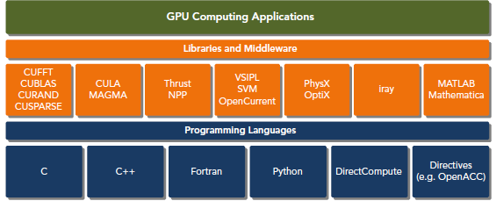
From hardware to software: GPU execution mode
CUDA overview
A parallel computing platform that leverages NVIDIA GPUs
Capable of automatic Scalability
Accessible through CUDA libraries, compiler directives, application programming interfaces, and extensions to several programming languages (C/C++, Fortran, and Python).

Slide 19
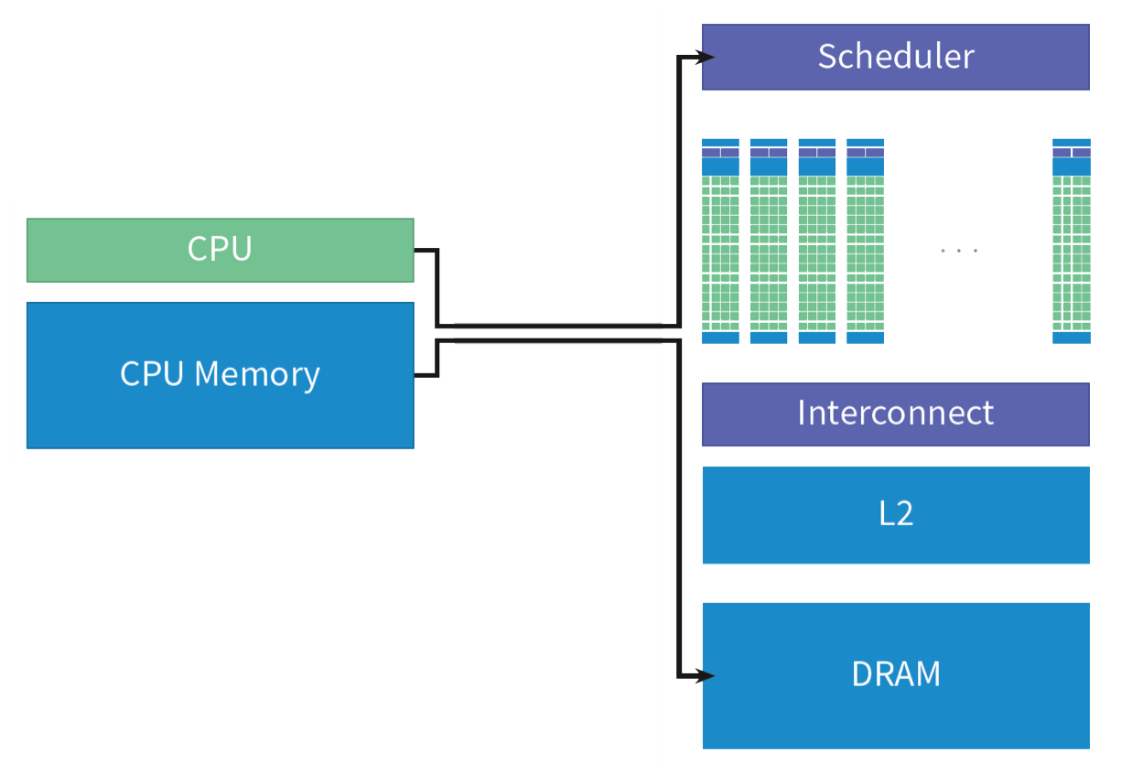
From hardware to software: GPU execution mode
CUDA processing flow
Copy program instructions from host to device; transfer data from the host to device memory.

Slide 20
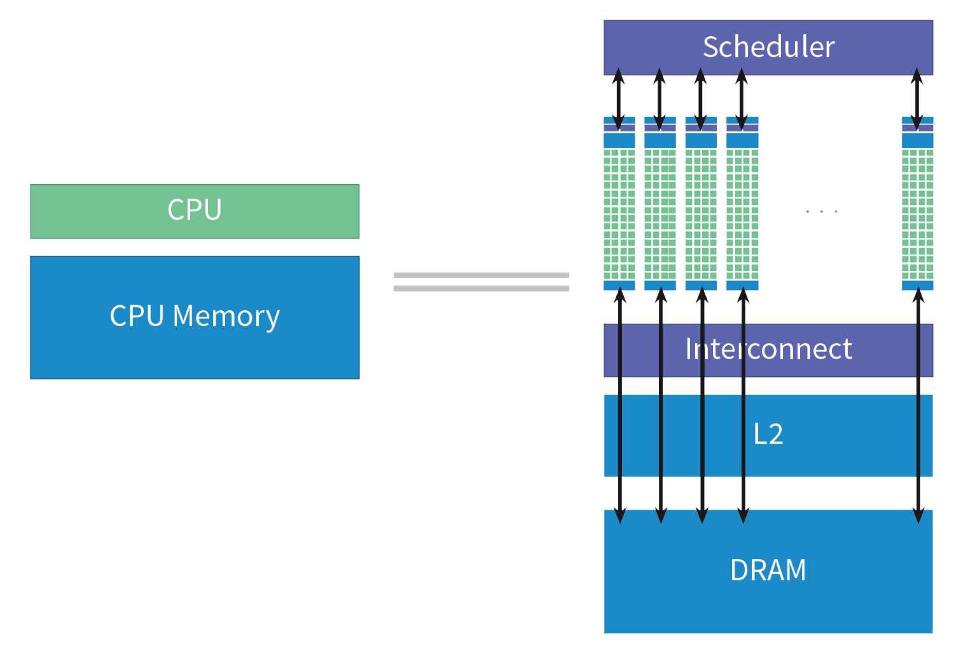
From hardware to software: GPU execution mode
CUDA processing flow
Copy program instructions from host to device; transfer data from the host to device memory.
Execute instructions on SMs; get data from memory; write back

Slide 21
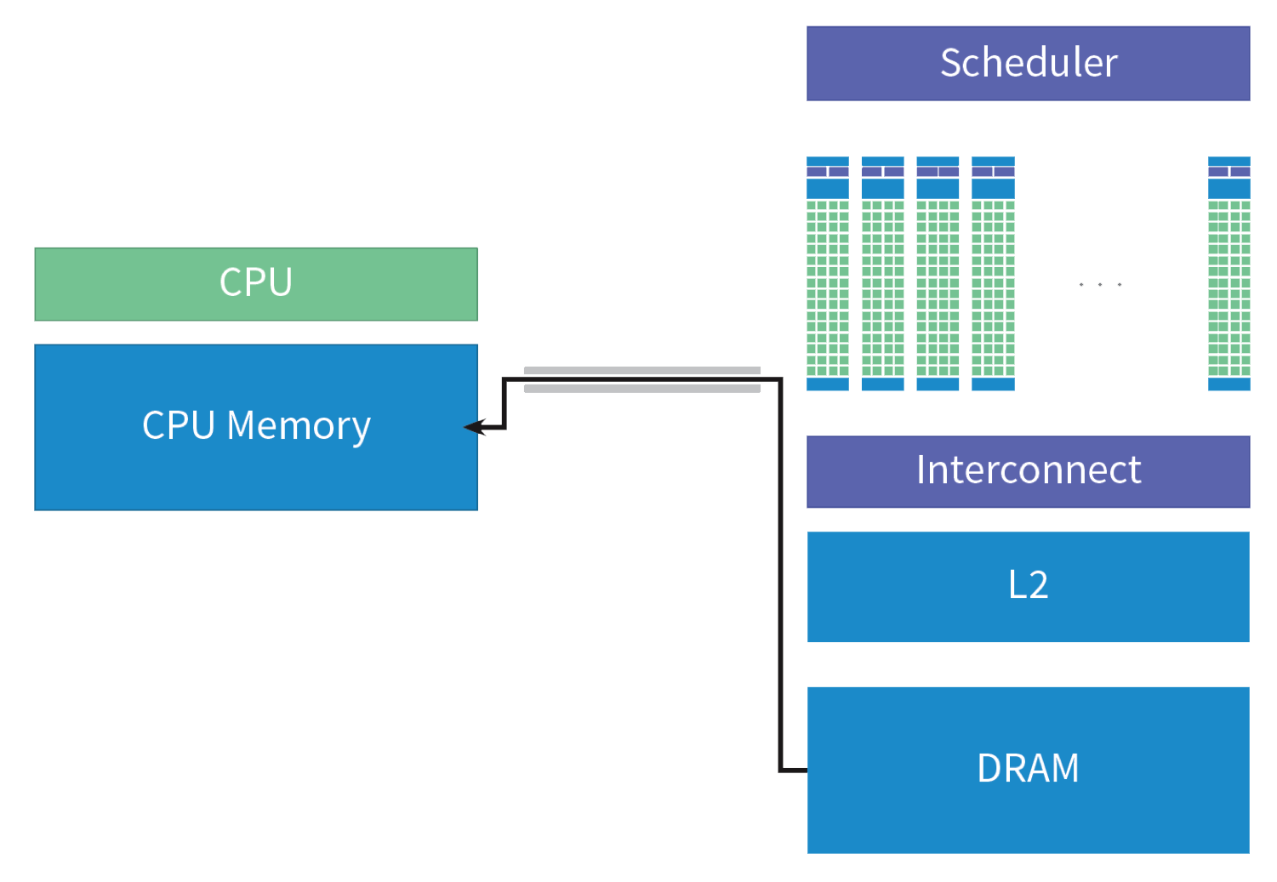
From hardware to software: GPU execution mode
CUDA processing flow
Copy program instructions from host to device; transfer data from the host to device memory.
Execute instructions on SMs; get data from memory; write back
Transfer results from the device back to host memory

Slide 22
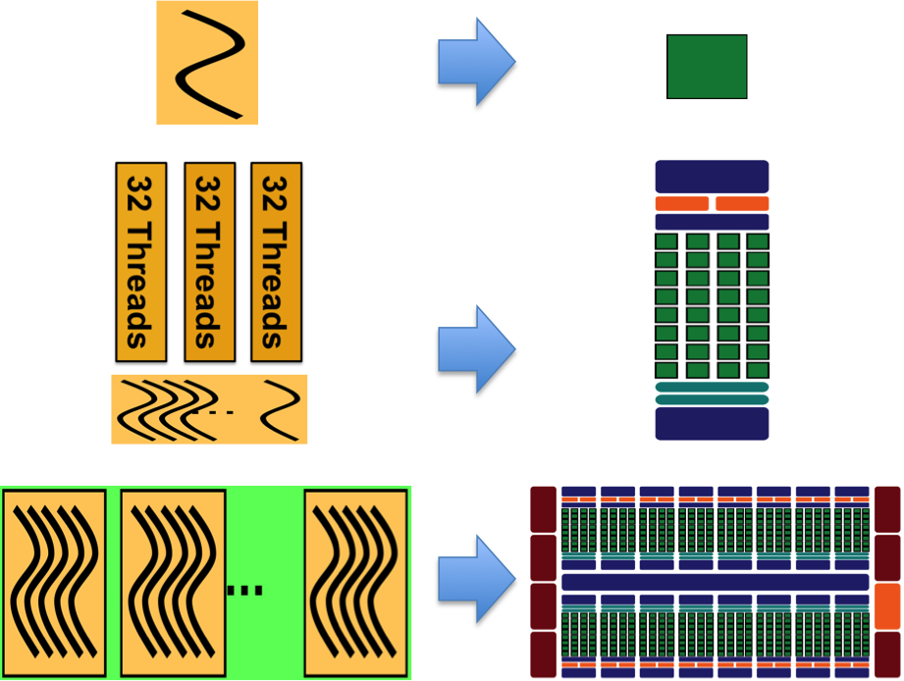
From hardware to software: GPU execution model
CUDA-enabled GPU execution: Partition one computation into blocks of threads mapped to massive parallelism of device
One thread executes on one CUDA core
has its own instruction address counter
has its own register state
can have an independent execution path
instructions within a single thread are pipelined to leverage instruction-level parallelism
Software
Hardware
Notes:
A thread executes on a CUDA core
Each thread has its own instruction address counter
Each thread has its own register state
Each thread can have an independent execution path (i.e. carries out current instruction on its own data)
Instructions within a single thread are pipelined to leverage instruction-level parallelism

Slide 23
From hardware to software: GPU execution model
CUDA-enabled GPU execution: Partition one computation into blocks of threads mapped to massive parallelism of device
One thread executes on one CUDA core
Thread blocks execute on a SM
Threads in groups of 32 called “warps”.
All threads in a warp execute the same instruction concurrently managed via SIMT.
Each SM partitions thread blocks assigned to it into warps and schedules them for execution on available hardware resources.
Several concurrent thread blocks can reside on one SM but don’t migrate between SMs.
Software
Hardware
SIMT: Single Instruction Multiple Thread
Notes:
A thread executes on a CUDA core
Each thread has its own instruction address counter
Each thread has its own register state
Each thread can have an independent execution path (i.e. carries out current instruction on its own data)
Instructions within a single thread are pipelined to leverage instruction-level parallelism

Slide 24
From hardware to software: GPU execution model
CUDA-enabled GPU execution: Partition one computation into blocks of threads mapped to massive parallelism of device
One thread executes on one CUDA core
Thread blocks execute on a SM
All thread blocks form a grid that runs on the device
NVIDIA categorizes its CUDA-enabled devices by compute capability
Represented by a version number("SM version”) identifying features supported by GPU hardware
More details: nvidia/cuda/cuda-c-programming-guide
Software
Hardware
SIMT: Single Instruction Multiple Thread
Notes:
A thread executes on a CUDA core
Each thread has its own instruction address counter
Each thread has its own register state
Each thread can have an independent execution path (i.e. carries out current instruction on its own data)
Instructions within a single thread are pipelined to leverage instruction-level parallelism

Slide 25
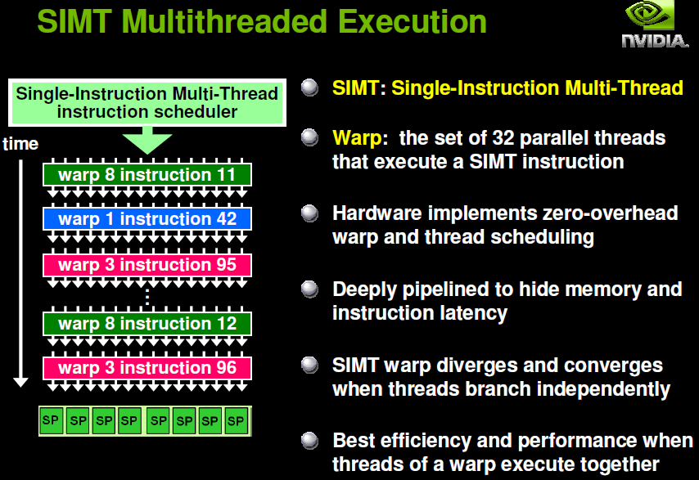
From hardware to software: GPU execution model
CUDA-enabled GPU execution
More about SIMT
an execution model (NVIDIA) where multiple independent threads execute concurrently using a single instruction.
CPU core ≈ GPU multiprocessor (SM )
Working unit: set of threads (32, a warp )
Fast switching of threads (large register file)

Slide 26
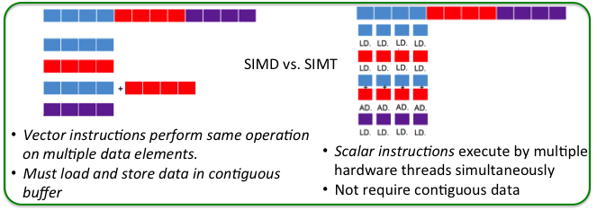
From hardware to software: GPU execution model
CUDA-enabled GPU execution
More about SIMT
similar to SIMD parallelism by broadcasting same instruction to multiple execution units
different from SIMD by allowing multiple threads in the same warp to execute independently
enables to write thread-level parallel code for independent scalar threads as well as data-parallel code for coordinated threads
SIMD: single instruction multiple data

Slide 27
Topics
GPU computing overview
CUDA programming basics
CUDA optimization
CUDA libraries
What and Why GPUs?
GPU architectures
From hardware to software: CUDA-enabled GPU execution mode
P0:Installing and running CUDA

Slide 28
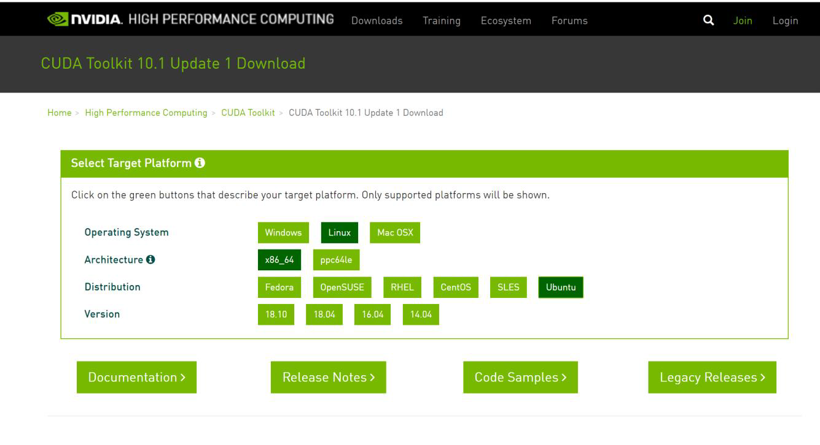
Installing and running CUDA
Installing CUDA
CUDA is supported on Windows, Linux and MacOSX (https://developer.nvidia.com/cuda-downloads)
Driver: Low-level software that controls the graphics card.
Toolkit
Nvcc compiler for CUDA
NsightIDE tool for Profiling
Several libraries
Running CUDA C program
Create a source code file with the name extension of .cu.
Compile the program using the CUDA compiler.
Run the executable file from the command line.

Slide 29
Installing and running CUDA
/*Code example: hello world from GPU*/
Get the CUDA source Code: P0-0_hellofromGPU.cu
Compiling the code
nvcc –o <exe> <source_file> -I/cudaIncludePath –L/CudaLibPath –lcuda –lcudart
directories for #include files
directories for libraries
libraries to be linked
Executing a CUDA Program
$ ./a.out
Hello World from CPU!
Hello World from GPU!
Hello World from GPU!
Hello World from GPU!
Hello World from GPU!
Hello World from GPU!
Hello World from GPU!
Hello World from GPU!
Hello World from GPU!
Hello World from GPU!
Hello World from GPU!

Slide 30
Installing and running CUDA
/*Code example: scalar addition on GPU*/
Get the CUDA source Code: P0-1_ScalarAdd.cu
Compiling the code
nvcc –o <exe> <source_file> -I/cudaIncludePath –L/CudaLibPath –lcuda –lcudart
directories for #include files
directories for libraries
libraries to be linked
Executing a CUDA Program
$ ./a.out
7

Slide 31
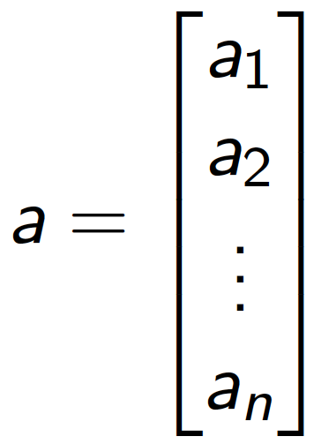
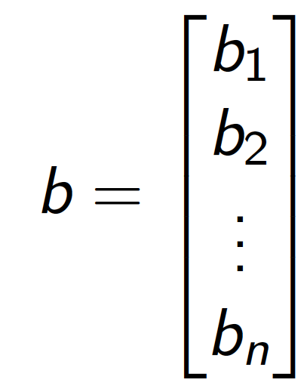
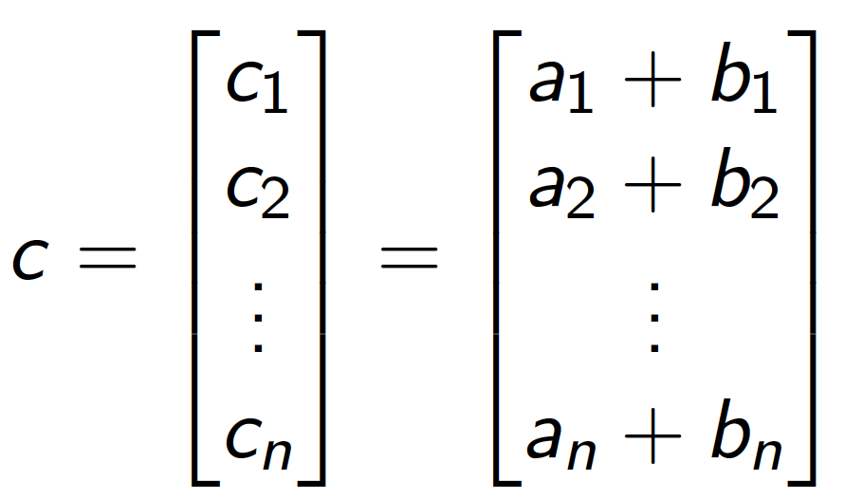
Installing and running CUDA
/*Example-1-2: Vector Addition by GPU*/
Get the CUDA source Code: P0-2_vectorAdd.cu
Compiling the Code
nvcc –o <exe> <source_file> -I/cudaIncludePath –L/CudaLibPath –lcuda –lcudart
directories for #include files
directories for libraries
libraries to be linked

Slide 32
Installing and running CUDA
/*Example-1-2: Vector Addition by GPU*/
Executing
~/NVIDIA_CUDA-version_Samples/0_Simple/$ ./vectorAdd
[Vector addition of 50000 elements]
Copy input data from the host memory to the CUDA device
CUDA kernel launch with 196 blocks of 256 threads
Copy output data from the CUDA device to the host memory
“ a + b = c ”
0.84019 + 0.39438 = 1.23457
0.78310 + 0.79844 = 1.58154
0.91165 + 0.19755 = 1.10920
0.33522 + 0.76823 = 1.10345
...............................................
0.78900 + 0.84517 = 1.63417
0.66494 + 0.30764 = 0.97258
Test PASSED
Done
50000 elements

Slide 33
GPU computing overview: summary
What and Why GPUs?
GPU architectures
From hardware to software: CUDA-enabled GPU execution mode
Installing and running CUDA
How to write a CUDA C program?

Slide 34
Topics
GPU computing overview
CUDA programming basics
CUDA optimization
CUDA libraries
CUDA program Skeleton
Thread hierarchy
Memory hierarchy

Slide 35
CUDA program Skeleton
What are the key components in a CUDA C program?
Back to example P0-0_hellofromGPU.cu
#include <stdio.h>
/*A simple introduction to programming in CUDA. This program prints "Hello World from GPU! from 10 CUDA threads running on the GPU. */
__global__ void helloFromGPU()
{
printf("Hello World from GPU!\n");
}
int main(int argc, char **argv)
{
printf("Hello World from CPU!\n");
helloFromGPU<<<1, 10>>>();
CHECK(cudaDeviceReset());
return 0;
}
Two new syntactic elements…

Slide 36
CUDA program Skeleton
What are the key components in a CUDA C program?
Back to example P0-0_hellofromGPU.cu
#include <stdio.h>
/*A simple introduction to programming in CUDA. This program prints "Hello World from GPU! from 10 CUDA threads running on the GPU. */
__global__ void helloFromGPU()
{
printf("Hello World from GPU!\n");
}
int main(int argc, char **argv)
{
printf("Hello World from CPU!\n");
helloFromGPU<<<1, 10>>>();
CHECK(cudaDeviceReset());
return 0;
}
“ __global__” declares a function:
Called “Kernel”
Indicates the kernel code will be run on device(GPU)
“helloFromGPU<<<1, 10>>>()”:
Called “Kernel launch”
Triple angle brackets mark a call from host code to device code
Numbers inside triple-angle-brackets defines kernel’s execution configuration on device

Slide 37
CUDA program Skeleton
What are the key components in a CUDA C program?
Back to example P0-0_hellofromGPU.cu
#include <stdio.h>
/*A simple introduction to programming in CUDA. This program prints "Hello World from GPU! from 10 CUDA threads running on the GPU. */
__global__ void helloFromGPU()
{
printf("Hello World from GPU!\n");
}
int main(int argc, char **argv)
{
printf("Hello World from CPU!\n");
helloFromGPU<<<1, 10>>>();
CHECK(cudaDeviceReset());
return 0;
}
A CUDA program has two parts: host code executing on host and interfaces to device; Kernel code which runs on device.
Host code starts running, and when first encounter device kernel, device code is sent to device and function is launched on device

Slide 38
CUDA program Skeleton
How to pass parameters and data between host and device?
/*integers addition: a + b = c */
Example P0-1_scalarAdd.cu
__global__ void add(int *a, int *b, int *c)
{
*c = *a + *b;
}
A kernel to add two integers
The kernel “add()” will execute on the device and will be called from the host
add() runs on the device, so a, b and c must point to device memory
How to point to device memory?

Slide 39
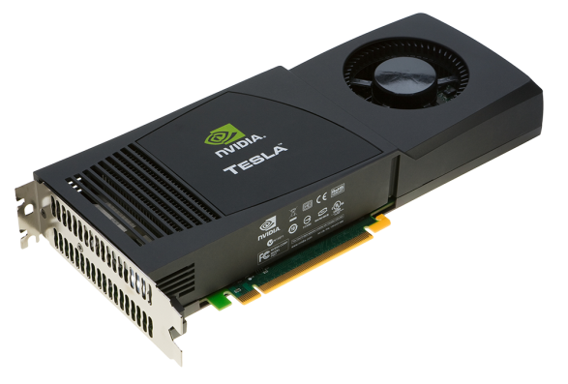
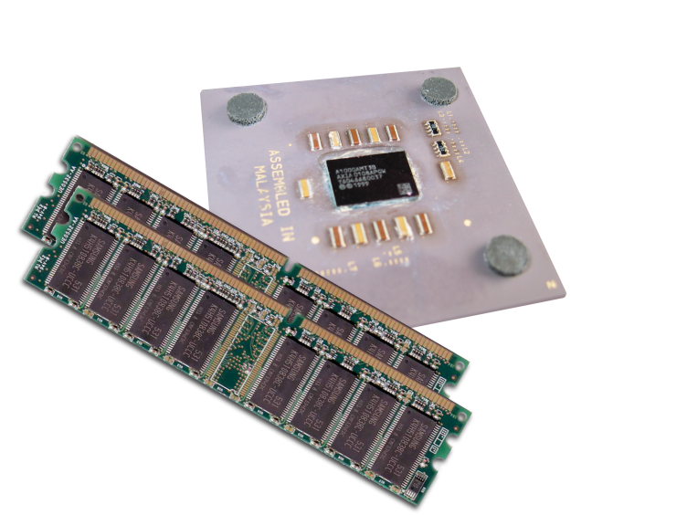
CUDA program Skeleton
How to pass parameters and data between host and device?
device and host memory are separate entities
“Device pointers” point to GPU memory that may be passed to/from host code but not be dereferenced in host code
“Host pointers” point to CPU memory that may be passed to/from device code but not be dereferenced in device code
Simple CUDA API for handling device memory
cudaMalloc(), cudaFree(), cudaMemcpy()
Similar to the C equivalents malloc(), free(), memcpy()
Let’s take a look at main()…

Slide 40
CUDA program Skeleton
How to pass parameters and data between host and device?
int main(void) {
int a, b, c; // host copies of a, b, c
int *d_a, *d_b, *d_c; // device copies of a, b, c
int size = sizeof(int);
// Allocate space for device copies of a, b, c
cudaMalloc((void **)&d_a, size);
cudaMalloc((void **)&d_b, size);
cudaMalloc((void **)&d_c, size);
// Setup input values
a = 2;
b = 7;

Slide 41
CUDA program Skeleton
How to pass parameters and data between host and device?
// Copy inputs to device
cudaMemcpy(d_a, &a, size, cudaMemcpyHostToDevice);
cudaMemcpy(d_b, &b, size, cudaMemcpyHostToDevice);
// Launch add() kernel on GPU
add<<<1,1>>>(d_a, d_b, d_c);
// Copy result back to host
cudaMemcpy(&c, d_c, size, cudaMemcpyDeviceToHost);
// Cleanup
cudaFree(d_a); cudaFree(d_b); cudaFree(d_c);
return 0;
}

Slide 42
CUDA program structure
__global__ void some_kernel(...){
...
}
int main (void){
// Declare all variables.
...
// Allocate host memory and device memory .
...
// Write data to host memory
...
//copy them to device memory.
...
// Kernel invocation code to launch kernel on device.
...
// Copy GPU results in device memory back to host memory.
...
// Free allocated host memory and device memory
...
}
Skeleton of a CUDA program
Write and launch a kernel for device
Parameters and data transfer between host and device
How to run a code in parallel on device?

Slide 43
Topics
GPU computing overview
CUDA programming basics
CUDA optimization
CUDA libraries
CUDA program Skeleton
Thread hierarchy
Memory hierarchy

Slide 44
Thread hierarchy
Ho to run code in parallel?
Back to example P0-2_vectorAdd.cu
__global__ void
vectorAdd(const float *A, const float *B, float *C, int numElements)
{
int i = blockDim.x * blockIdx.x + threadIdx.x;
if (i < numElements)
{C[i] = A[i] + B[i];}
}
int main(void){
…
int threadsPerBlock = 256;
int blocksPerGrid =(numElements + threadsPerBlock - 1) / threadsPerBlock;
vectorAdd<<<blocksPerGrid, threadsPerBlock>>>(d_A, d_B, d_C, numElements);
…
}
What are they?

Slide 45
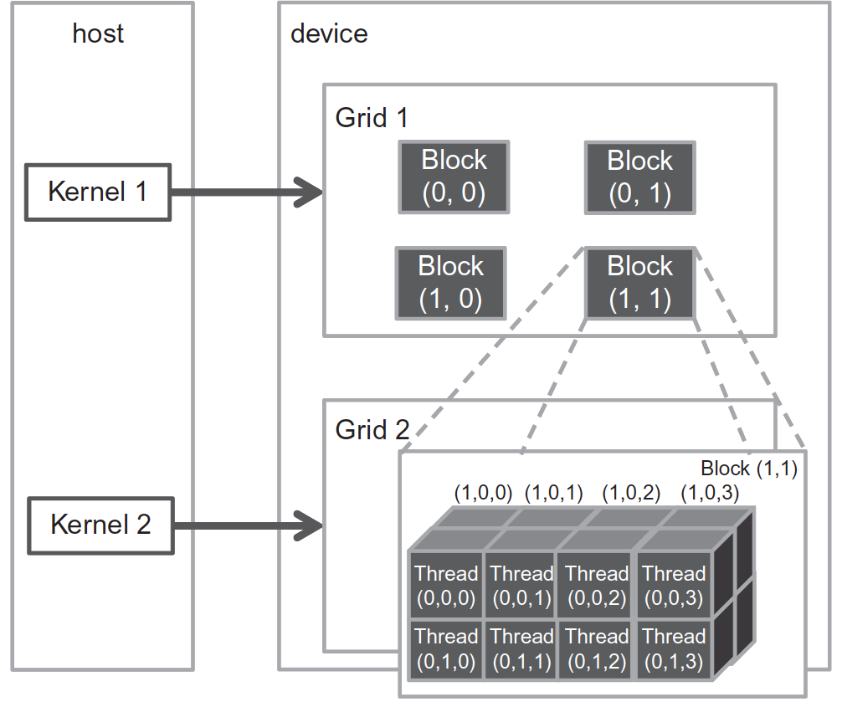
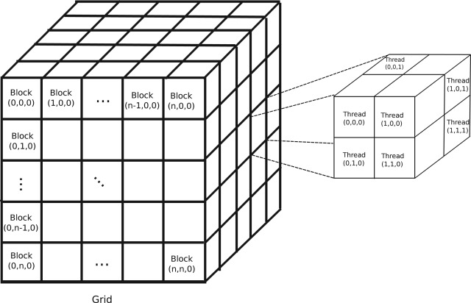
Thread hierarchy
What is Thread hierarchy?
Thread hierarchy: A CUDA kernel is executed by an array of threads; threads are organized into blocks; blocks are organized into grids

Slide 46
Thread hierarchy
What is Thread hierarchy?
“dim3” to define Grid/Block structures
//Define a 3D vector containing the dimensions of grid (x-axis, y-axis, and z-axis)
dim3 GridDim(gridDim.x, gridDim.y, gridDim.z);
//Define a 3D vector containing the dimensions of thread block (x-axis, y-axis, and z-axis)
dim3 BlockDim (BlockDim.x, BlockDim.y, BlockDim.z);
//dimension defaults to 1 if not set explicitly
Example: A 2D Grid containing 3D Blocks
dim3 grid(16,16); // grid = 16 x 16 x 1 blocks
dim3 block(32,32, 32); // block = 32 x 32x 32 threads
Notes:
//Define a 3D vector containing the dimensions of grid (x-axis, y-axis, and z-axis; gridDim.z is usually not used; a constant that is set at kernel launch time; each dimension defaults to 1 if not set explicitly)
dim3 GridDim(gridDim.x, gridDim.y, gridDim.z);
//Define a 3D vector containing the dimensions of thread block (x-axis, y-axis, and z-axis; a constant that is set at kernel launch time; each dimension defaults to 1 if not set explicitly)
dim3 BlockDim (BlockDim.x, BlockDim.y, BlockDim.z);

Slide 47
Thread hierarchy
What is Thread hierarchy?
Indices for threads and block indices
blockIdx.[x,y,z]
3-component vector returning to zero-based index of block along x/y/z-axis
threadIdx.[x,y,z]
3-component vector specifying zero based index along x/y/z-axis within the thread block
Thread’s 3D index relative to the grid
x_index = blockIdx.x*blockDim.x + threadIdx.x;
y_index = blockIdx.y*blockDim.y + threadIdx.y;
z_index = blockIdx.z*blockDim.z + threadIdx.z;
Global Thread Identification
unique ID to each one of the threads thereby being linearized
determined by the indices of threads and block

Slide 48
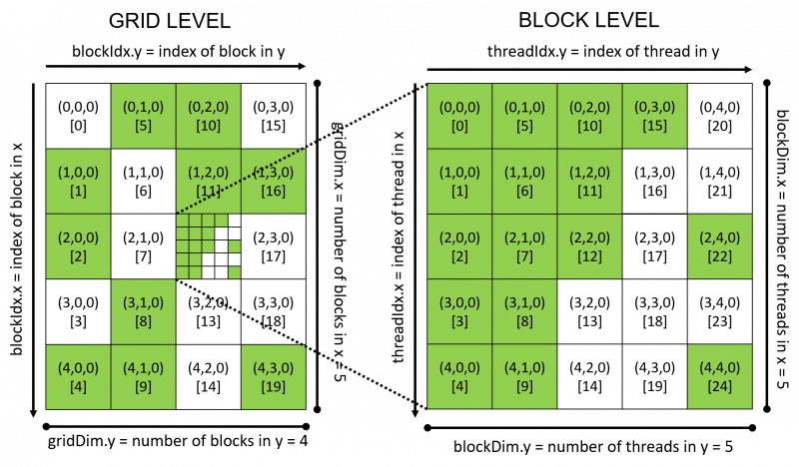
Thread hierarchy
What is Thread hierarchy?
Indices for threads and block: threadId in 2Dgrid and 2Dblock
Griddim: (5,4,1)
Blockdim: (5,5,1)
blockId = blockIdx.x + blockIdx.y * gridDim.x;
threadId = blockId * (blockDim.x * blockDim.y)
+ (threadIdx.y * blockDim.x) + threadIdx.x
The threadId in other grid/block dimension in https://cs.calvin.edu/courses/cs/374/CUDA/CUDA-Thread-Indexing-Cheatsheet.pdf
https://www.pelagos-consulting.com/?p=503

Slide 49
Thread hierarchy
Mapping threads to multidimensional data
Steps to determine the grid and block dimensions for a given data size:
Decide the block size.
Calculate the grid dimension based on the application data size and the block size.
Check kernel performance characteristics and limitations on device resources in determining grid/block dimension
Code examples
P1-0_Indexing-Matrices-with-Blocks-and-Threads
P1-1_MatrixSummation-with-2Dgrid-and-2Dblocks
P1-2_MatrixMultiplication-with-2Dgrid-and-2Dblocks

Slide 50
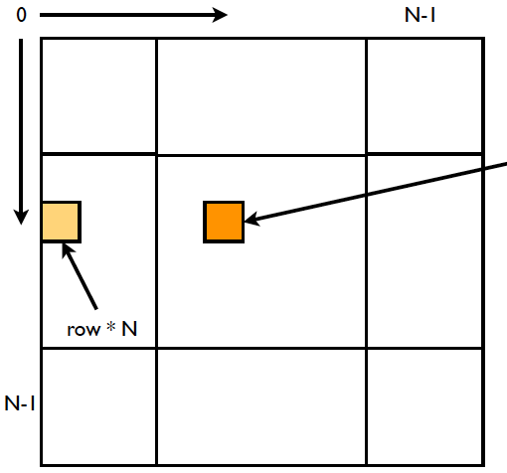
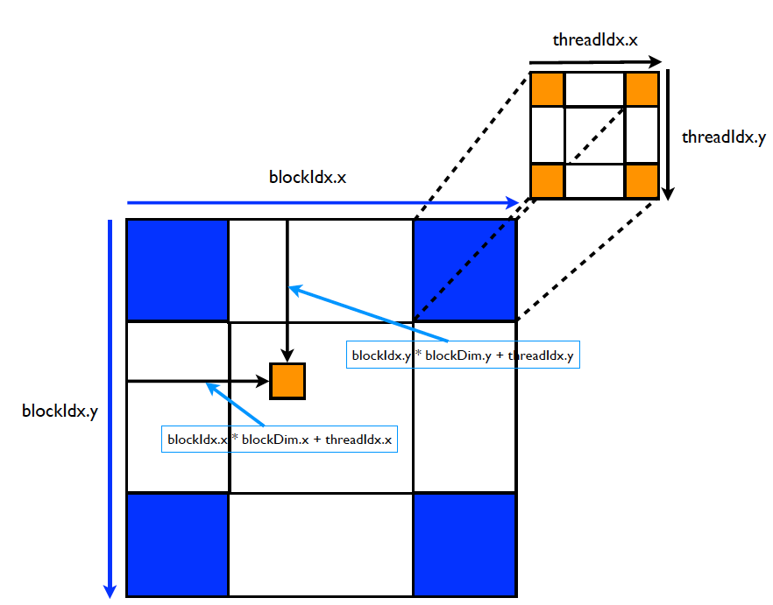
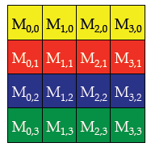
Thread hierarchy
Mapping threads to multidimensional data
P1-0_Indexing-Matrices-with-Blocks-and-Threads
Layout of a 2D grid with 2D blocks for matrix operations
Blockidx.x
threadidx.x
Blockidx.y
threadidx.y
C language: Row-major order to store matrix linearly in global memory

Slide 51
Thread hierarchy
Mapping threads to multidimensional data
P1-0_Indexing-Matrices-with-Blocks-and-Threads
Flatten Matrices into Linear Memory
Map the thread and block index to the coordinate of a matrix:
ix = threadIdx.x + blockIdx.x * blockDim.x
iy = threadIdx.y + blockIdx.y * blockDim.y
Map a matrix coordinate to a global memory location/index:
idx = iy * nx + ix
Matrix coordinate: (ix,iy)
Global linear memory index: idx = iy*nx + ix
Corresponding element in each coordinate: A[ix][iy] = A[idx]

Slide 52
Thread hierarchy
Mapping threads to multidimensional data
P1-0_Indexing-Matrices-with-Blocks-and-Threads
__global__ void printThreadIndex(int *A, const int nx, const int ny){
int ix = threadIdx.x + blockIdx.x * blockDim.x;
int iy = threadIdx.y + blockIdx.y * blockDim.y;
unsigned int idx = iy * nx + ix;
printf("thread_id (%d,%d) block_id (%d,%d) coordinate (%d,%d) global index %2d ival %2d\n", threadIdx.x, threadIdx.y, blockIdx.x, blockIdx.y, ix, iy, idx, A[idx]s);
}
int main(int argc, char **argv){
…
int nx = 8; ny = 6; nxy = nx * ny;
…
dim3 block(4, 2);
dim3 grid((nx + block.x - 1) / block.x, (ny + block.y - 1) / block.y);
printThreadIndex<<<grid, block>>>(d_MatA, nx, ny);
…
}
// set matrix dimension
// set up execution configuration
// invoke the kernel

Slide 53
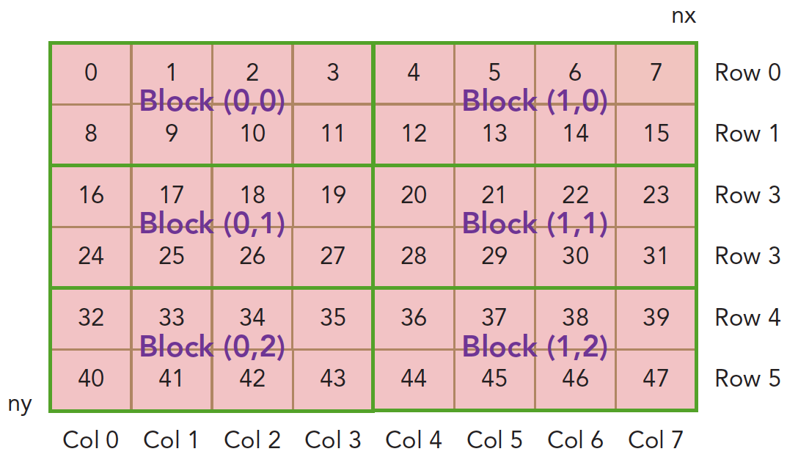
Thread hierarchy
Mapping threads to multidimensional data
P1-0_Indexing-Matrices-with-Blocks-and-Threads
$ nvcc checkThreadIndex.cu -o checkIndex
$ ./checkIndex
The information for each thread will be printed, including:
thread_id (x, y); block_id (x, y); coordinate(x, y) ; global index (x, y); ival x;
thread_id (2,1)
block_id (1,0)
coordinate (6,1)
global index 14
ival 14

Slide 54
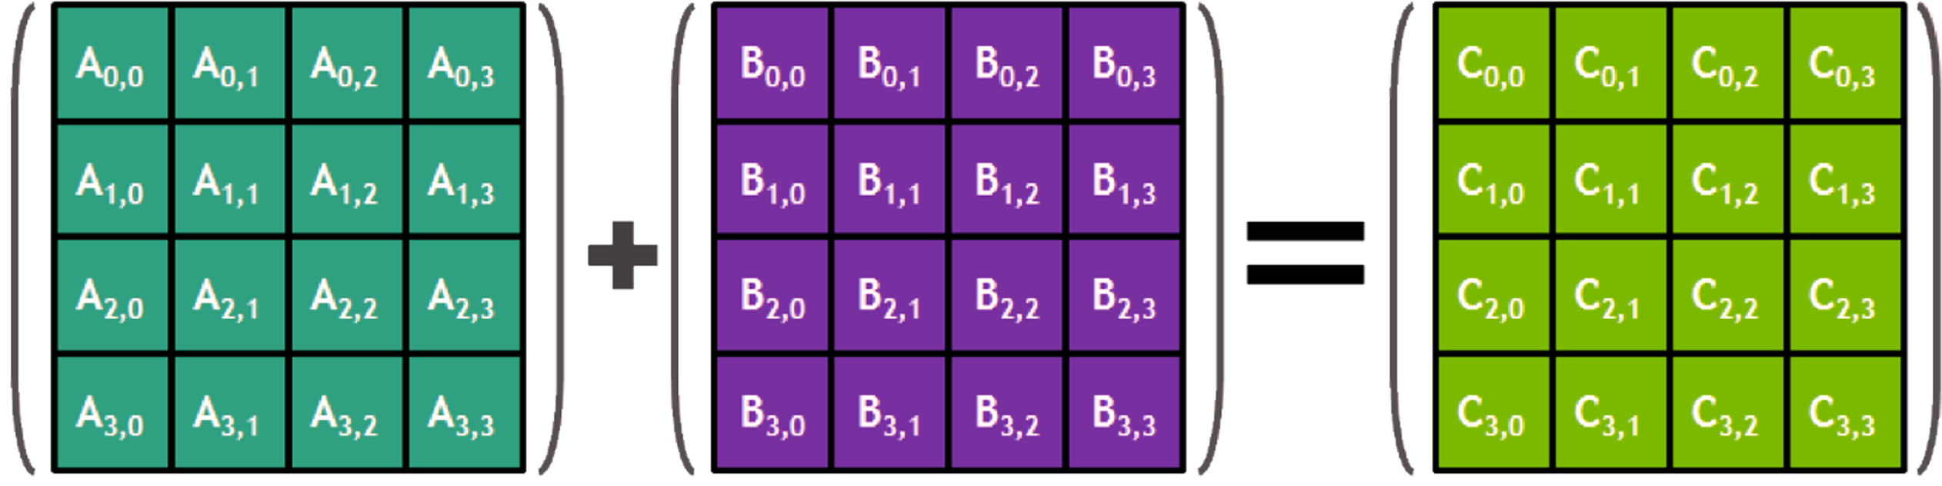
Thread hierarchy
Mapping threads to multidimensional data
P1-1_MatrixSummation-with-2Dgrid-and-2Dblocks
Corresponding elements of each array (A; B) added together to form element of third array (C): Aij + Bij = Cij
Two steps in CUDA C implementation
Step 1. Create a kernel to sum matrix with a 2D thread block
Step 2. Determine matrices and kernel execution configuration in main function

Slide 55
Thread hierarchy
Mapping threads to multidimensional data
P1-1_MatrixSummation-with-2Dgrid-and-2Dblocks
CUDA C implementation Step 1
__global__ void sumMatrixOnGPU2D(float *MatA, float *MatB, float *MatC, int nx, int ny)
{
unsigned int ix = threadIdx.x + blockIdx.x * blockDim.x;
unsigned int iy = threadIdx.y + blockIdx.y * blockDim.y;
unsigned int idx = iy * nx + ix;
if (ix < nx && iy < ny)
MatC[idx] = MatA[idx] + MatB[idx];
}

Slide 56
Thread hierarchy
Mapping threads to multidimensional data
P1-1_MatrixSummation-with-2Dgrid-and-2Dblocks
CUDA C implementation Step 2
int main(int argc, char **argv){
…
int nx = 1 << 14;
int ny = 1 << 14;
int nxy = nx * ny;
// malloc host and initialize data at host
// malloc device global memory and transfer data from host to device
// invoke kernel at host side
int dimx = 32; dimy = 32;
dim3 block(dimx, dimy);
dim3 grid((nx + block.x - 1) / block.x, (ny + block.y - 1) / block.y);
sumMatrixOnGPU2D<<<grid, block>>>(d_MatA, d_MatB, d_MatC, nx, ny);
…
}
// set up data size of matrix, 16,384 elements in each dimension
//Use block size of (32, 32, ,1) and calculate grid dimension

Slide 57
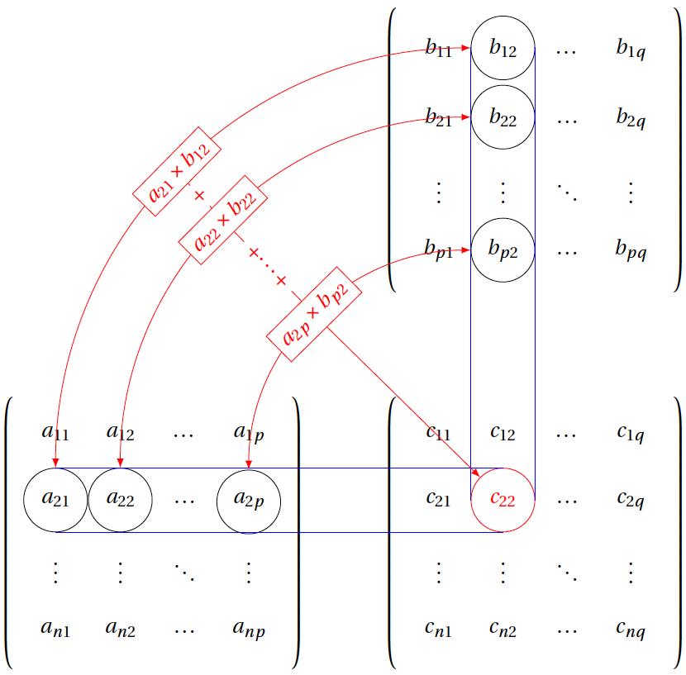
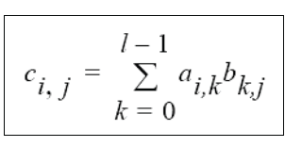
Thread hierarchy
Mapping threads to multidimensional data
P1-2_MatrixMultiplication-with-2Dgrid-and-2Dblocks
B[p, q]
Multiply rows of A by columns of B and add them up
place the sum in the appropriate position in the matrix C
C[n, q]
A[n, p] x B[p, q] = C[n, q]
A[n, p]
http://www.texample.net/tikz/examples/matrix-multiplication/

Slide 58
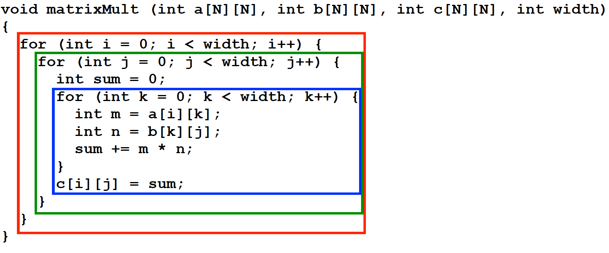
Thread hierarchy
Mapping threads to multidimensional data
P1-2_MatrixMultiplication-with-2Dgrid-and-2Dblocks
Sequential algorithm for Matrix Multiplication
Multiple nested for loops.
Both multiplications and additions are in O(N3).
Need parallelization to improve efficiency

Slide 59
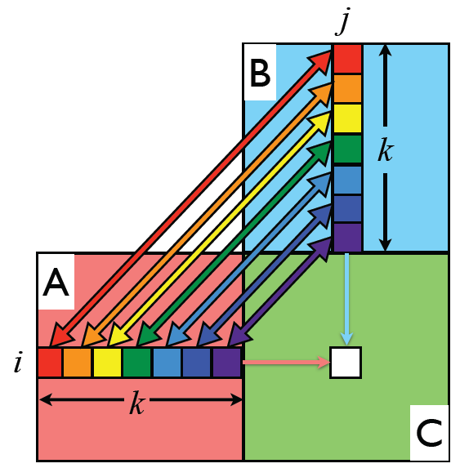
Thread hierarchy
Mapping threads to multidimensional data
P1-2_MatrixMultiplication-with-2Dgrid-and-2Dblocks
Parallel Matrix Multiplication Algorithm
Only one thread is required to traverse the ith row of A and the jth column of B in computing a single value of C(i,j), .
Number of threads needed to compute a square matrix multiply is O(N2).
/* Matrix multiplication with a 2D Grid and 2D Blocks*/

Slide 60
Thread hierarchy
Mapping threads to multidimensional data
P1-2_MatrixMultiplication-with-2Dgrid-and-2Dblocks
CUDA device code for Matrix Multiplication
__global__ void matrixMult (int *a, int *b, int *c, int width) {
int k, sum = 0;
int col = threadIdx.x + blockDim.x * blockIdx.x;
int row = threadIdx.y + blockDim.y * blockIdx.y;
if(col < width && row < width) {
for (k = 0; k < width; k++)
sum += a[row * width + k] * b[k * width + col];
c[row * width + col] = sum;
}
}

Slide 61
Thread hierarchy
Mapping threads to multidimensional data
P1-2_MatrixMultiplication-with-2Dgrid-and-2Dblocks
int main() {
int a[N][N], b[N][N], c[N][N];
int *dev_a, *dev_b, *dev_c;
int size = N * N * sizeof(int);
cudaMalloc((void **) &dev_a, size);
cudaMalloc((void **) &dev_b, size);
cudaMalloc((void **) &dev_c, size);
cudaMemcpy(dev_a, a, size, cudaMemcpyHostToDevice);
cudaMemcpy(dev_b, b, size, cudaMemcpyHostToDevice);
dim3 dimGrid(1, 1);
dim3 dimBlock(N, N);
matrixMult<<<dimGrid, dimBlock>>>(dev_a, dev_b, dev_c, N);
cudaMemcpy(c, dev_c, size, cudaMemcpyDeviceToHost);
cudaFree(dev_a); cudaFree(dev_b); cudaFree(dev_c);
}
CUDA host code for Matrix Multiplication

Slide 62
Topics
GPU computing overview
CUDA programming basics
CUDA optimization
CUDA libraries
CUDA program Skeleton
Thread hierarchy
Memory hierarchy

Slide 63
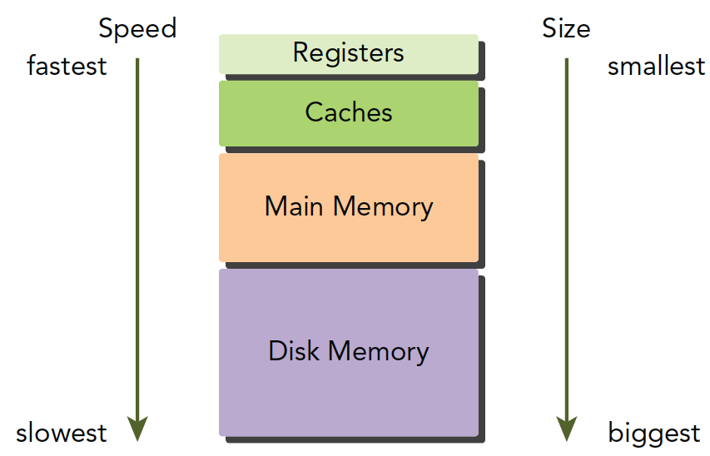
Memory hierarchy
Hierarchical memory design
One key challenge in modern computer architecture design is to ensure that processing cores can be fed with data to keep them busy
Large applications need lots of memory, but fast memory is very expensive to produce
Memory hierarchy consists of multiple levels of memory with different latencies, bandwidths, and capacities to optimize performance.
Memory hierarchy from lots of slower RAM up to very few but very fast registers

Slide 64
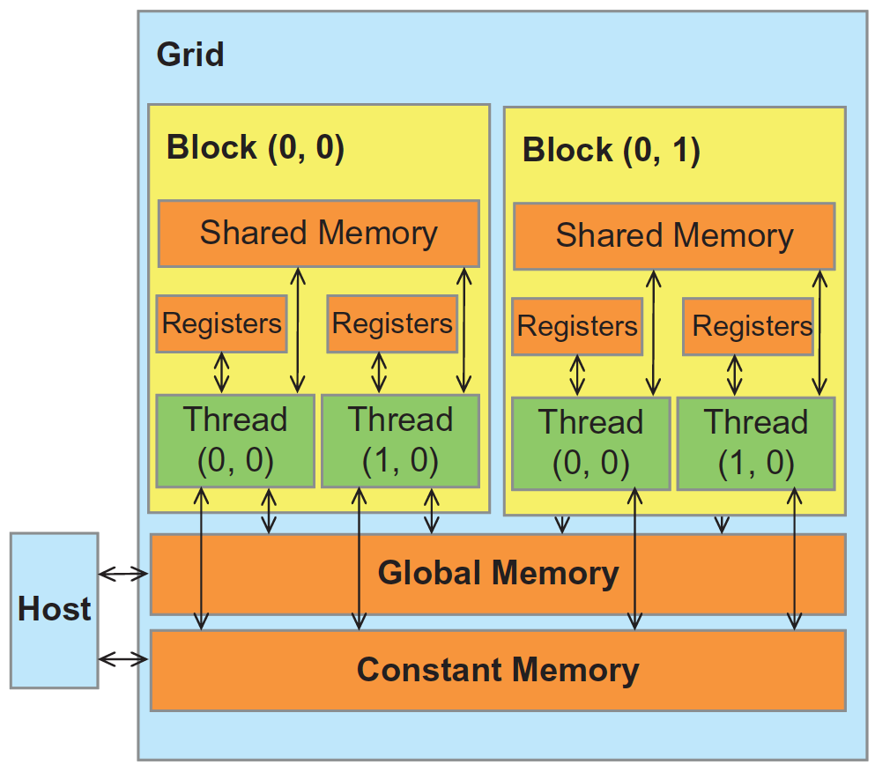
Memory hierarchy
CUDA device memory model
Hierarchical types of memory for control over its behavior
Registers
Local memory
Global memory
Shared memory
L1/L2/L3 cache
Constant memory
How threads interact through each type of the memory?
What value a read can return when does a value update become visible to other threads?
What assumptions are allowed to use memory when writing a program or applying some program optimization

Slide 65
Memory hierarchy
CUDA device memory model
Global memory
Separate from the device core (SM’s, caches, etc)
Be accessible from either host or device but has high latency access
Has lifetime of the whole application and contents visible to all threads
Device code can R/W per-grid global memory and per-thread registers
Global Memory Allocation
cudaMalloc()-- Allocates object in the device Global Memory
cudaFree() -- Frees object from device Global Memory
cudaMemcpy() -- memory data transfer (Host to Host; Host to Device; Device to Host; Device to Device)

Slide 66
Memory hierarchy
CUDA device memory model
Constant memory
Similar to global memory, except that they can’t be modified by kernels ( i.e. Read only)
Short latency and high bandwidth when all threads access the same location
Constant Memory Allocation
Can be defined with global scope outside kernel code using the prefix __constant__ (e.g. “__constant__ int foo[1024]”)
Can be initialized inside host code using cudaMemcpyToSymbol (e.g. “cudaMemcpyToSymbol(foo, h_src, sizeof(int) * 1024)”)

Slide 67
Memory hierarchy
CUDA device memory model
Shared memory
Located in SMs(i.e. on-chip)
Can be as fast as a registers
Accessible by any thread within the block from which it was created
Has the lifetime of the block
Shared Memory Allocation
Declared in kernel with the prefix “__shared__”
Can be allocated statically (size known at compile time) or dynamically (size not known until runtime)

Slide 68
Memory hierarchy
CUDA device memory model
Registers
Located in SMs (i.e. on-chip)
The fastest memory space
Private to each thread
Has lifetime with the thread.
Register variables
An automatic variable declared in a kernel without any other type qualifiers is generally assigned to a register
Register spills and local memory. What happens if one application needs more registers? (further details https://developer.download.nvidia.com/CUDA/training/register_spilling.pdf)

Slide 69
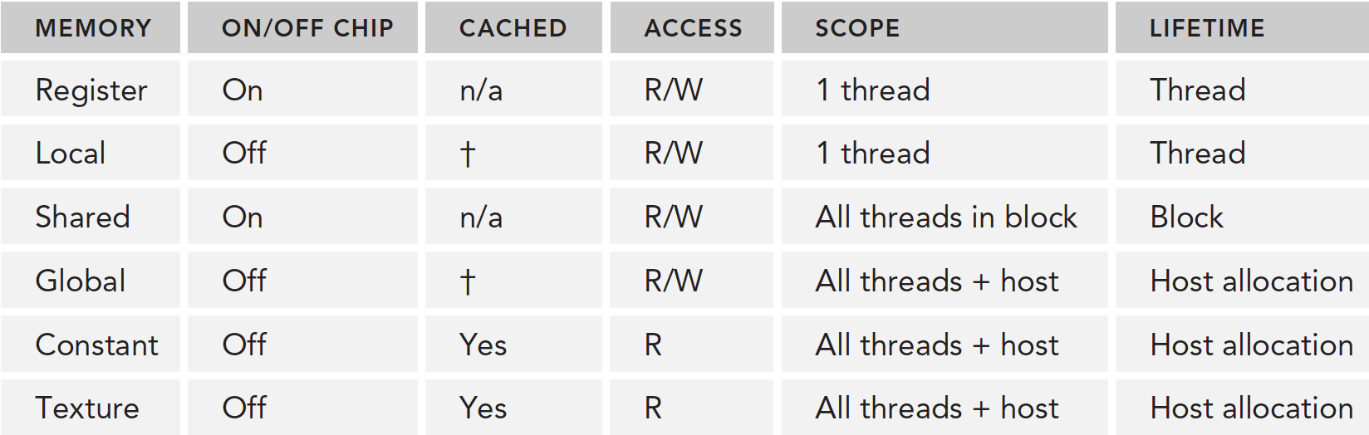
Memory hierarchy
Memory hierarchy
CUDA device memory model
Summary on principle traits for each type of memory
Threads in device code may access multiple memory spaces during its execution:
Read/write per-thread registers, per-thread local memory, per-block shared memory, per-grid global memory
Read/only per-grid constant memory
Host code can transfer the data to/from per grid global and constant memories
†only on devices of compute capability 2.x

Slide 70
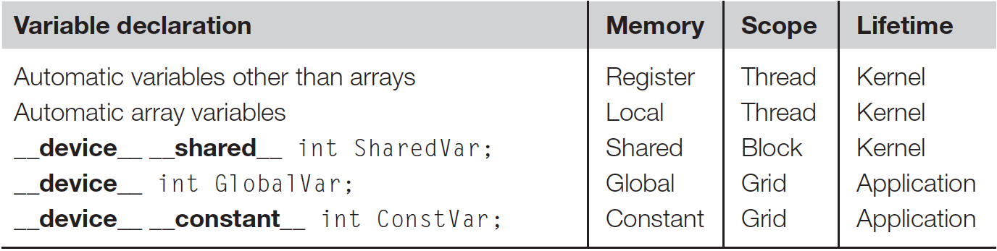
Memory hierarchy
Summary of CUDA syntax for variable declaration to different memories
The qualifier “__device__” indicates this is a global variable in the GPU
the variable can be read and modified by any kernel
its lifetime is the lifetime of the whole application
can also declare arrays of fixed size
can read/write by host code using standard cudaMemcpy
optional when used with __local__, __shared__, or __constant__

Slide 71
Memory hierarchy
Summary of CUDA syntax for variable declaration to different memories
The variable must be declared within the kernel function body, and will be available only within the kernel code.
Automatic variables without any qualifier reside in a register, scalar variables reside in fast, on-chip registers
Thread local array variable resides in (uncached off-chip) local memory,
Shared variables reside in fast, on-chip memories

Slide 72
Memory hierarchy
Summary of CUDA syntax for variable declaration to different memories
The variable must be declared outside of any function.
global variables reside in uncached off-chip memory
constant variables reside in cached off-chip memory (Currently total size of constant variables in an application is limited to 64KB)

Slide 73
Memory hierarchy
CUDA variable declaration practice examples
Global variable declaration (P1-3_globalVariable.cu)
__device__ float devData;
__global__ void checkGlobalVariable(){
// display the original value
printf("Device: the value of the global variable is %f\n", devData);
devData += 2.0f; // alter the value
}
int main(void){
float value = 3.14f; // initialize the global variable
cudaMemcpyToSymbol(devData, &value, sizeof(float));
printf("Host: copied %f to the global variable\n", value);
checkGlobalVariable<<<1, 1>>>(); // invoke the kernel
cudaMemcpyFromSymbol(&value, devData, sizeof(float));
printf("Host: the value changed by the kernel to %f\n", value);
cudaDeviceReset();
return EXIT_SUCCESS;
}
List 4-1 in Professional CUDA C programming

Slide 74
Memory hierarchy
CUDA variable declaration practice examples
Global variable declaration (P1-3_globalVariable.cu)
Compile and run this example with the following command:
$ nvcc globalVariable.cu -o globalVariable
$ ./globalVariable
The following is a sample output:
Host: copied 3.140000 to the global variable
Device: the value of the global variable is 3.140000
Host: the value changed by the kernel to 5.140000

Slide 75
Memory hierarchy
CUDA device memory model
Shared Memory Allocation (P1-4_shareVariable.cu)
This example demonstrates how to allocate paged memory and use shared memory. The program copies global memory contents to shared memory, multiplies contents by 10, stores it back to global memory.
Kernel Code
//Declaring Shared Memory
__shared__ int part_ary[BLOCKSIZE];
//Accessing Shared Memory
//copy global memory to shared memory
part_ary[tx]=ary[idx];
part_ary[tx]=part_ary[tx]*10;
//copy back to global memory
ary_out[idx]=part_ary[tx];
__syncthreads();
Host Code
//Device memory and Host memory
cudaMalloc((void **)&device_array, size);
cudaMalloc((void **)&device_array_out, size);
cudaMallocHost((void **)&host_array, size);
cudaMallocHost((void **)&host_array_out, size);
//Freeing Memory
cudaFree(device_array);
cudaFree(host_array);
cudaFree(device_array_out);
cudaFree(host_array_out);
https://cvw.cac.cornell.edu/gpu/shared_mem_exec

Slide 76
Review of CUDA programming basics
CUDA programming basics
Start from “Hello World from GPU!”
Write and launch CUDA C kernels
Utilize to hierarchical thread organization
Access to device memory of different types
Have the knowledge, till now, to write CUDA C programming in a correct way.
But how to measure and tune the program performance?

Slide 77
Topics
GPU computing overview
CUDA programming basics
Performance tuning
Libraries
Profiling tools
Kernel launch configuration
Improve global memory performance
Maximize usage of shared memory
Optimize control flow throughput

Slide 78
Performance insight with NVIDIA profiler
Why profiling performance?
Improvement possible only if program is measured-- Don’t trust your gut.
Ways to identify hotspots and bottlenecks :
Hotspots-- Which functions take most of the time?
Bottlenecks-- What are the limiters of performance
Manual timing tedious and error-prone even it is possible
Feasible only for small applications
Impractical for complex ones
Profiler
In-detail insights
No code changes needed!
Easy access to hardware counters

Slide 79
Performance insight with NVIDIA profiler
Performance Measurement: Timing kernel calls and executions
Timing Kernel Execution with CPU Timers.
cudaMemcpy(d_x, x, N*sizeof(float), cudaMemcpyHostToDevice);
cudaMemcpy(d_y, y, N*sizeof(float), cudaMemcpyHostToDevice);
t1 = myCPUTimer();
saxpy<<<(N+255)/256, 256>>>(N, 2.0, d_x, d_y);
cudaDeviceSynchronize();
t2 = myCPUTimer();
cudaMemcpy(y, d_y, N*sizeof(float), cudaMemcpyDeviceToHost);
Timing using CUDA Events
cudaEvent_t start, stop;
float time;
cudaEventCreate(&start);
cudaEventCreate(&stop);
cudaEventRecord( start, 0 );
kernel<<<grid,threads>>> ( d_odata, d_idata, size_x, size_y, NUM_REPS);
cudaEventRecord( stop, 0 );
cudaEventSynchronize( stop );
cudaEventElapsedTime( &time, start, stop );
cudaEventDestroy( start );
cudaEventDestroy( stop );

Slide 80
Performance insight with NVIDIA profiler
Profiling with nvprof
Command-line GPU profiler to profile CUDA kernels and API calls as well as host code.
Basic default profiling data, much more available with:
“--events E1,E2”: Measure specific events; list available events via “--query-events”
“--metrics M1,M2”: Measure combined metrics; list available metrics via “--query-metrics”
Further useful options:
--export-profile: Generate profiling data for visual profiler
--print-gpu-trace: Show trace of function calls
--help: For help…
More details:
http://docs.nvidia.com/cuda/profiler-users-guide/

Slide 81
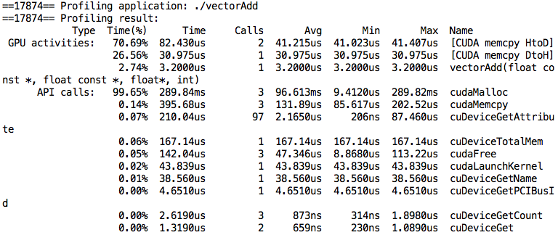

Performance insight with NVIDIA profiler
Profiling with nvprof
Example of using nvprof: P0_1_vectorAdd
==17874== Profiling application: ./vectorAdd
==17874== Profiling result:
Type Time(%) Time Calls Avg Min Max Name
GPU activities: 70.69% 82.430us 2 41.215us 41.023us 41.407us [CUDA memcpy HtoD]
26.56% 30.975us 1 30.975us 30.975us 30.975us [CUDA memcpy DtoH]
2.74% 3.2000us 1 3.2000us 3.2000us 3.2000us vectorAdd(float const *, float const *, float*, int)
API calls: 99.65% 289.84ms 3 96.613ms 9.4120us 289.82ms cudaMalloc
0.14% 395.68us 3 131.89us 85.617us 202.52us cudaMemcpy
0.07% 210.04us 97 2.1650us 206ns 87.460us cuDeviceGetAttribute
0.06% 167.14us 1 167.14us 167.14us 167.14us cuDeviceTotalMem
0.05% 142.04us 3 47.346us 8.8680us 113.22us cudaFree
0.02% 43.839us 1 43.839us 43.839us 43.839us cudaLaunchKernel
0.01% 38.560us 1 38.560us 38.560us 38.560us cuDeviceGetName
0.00% 4.6510us 1 4.6510us 4.6510us 4.6510us cuDeviceGetPCIBusId
0.00% 2.6190us 3 873ns 314ns 1.8980us cuDeviceGetCount
0.00% 1.3190us 2 659ns 230ns 1.0890us cuDeviceGet
0.00% 462ns 1 462ns 462ns 462ns cudaGetLastError
0.00% 385ns 1 385ns 385ns 385ns cuDeviceGetUuid

Slide 82

Performance insight with NVIDIA profiler
Visual profiler using nvprof and nvcc
Generate profiling output with nvprof:
~/$ nvprof –f –o profile.nvvp ./vectorAdd
Visualize results with nvcc
Timeline
~/$ nvvp ./profile.nvvp
Section properties
Section details

Slide 83
Topics
GPU computing overview
CUDA programming basics
Performance tuning
Libraries
Profiling tools
Kernel launch configuration
Improve global memory performance
Maximize usage of shared memory
Optimize control flow throughput

Slide 84
Kernel launch configuration
Consideration to optimize kernel launch configuration
Key to understand:
Thread instructions are executed sequentially, so executing other warps is the only way to hide latencies and keep the hardware busy
A thread stalls when one of the operands is not ready
Switching threads would hide latency
Optimization: keep the multiprocessors on device as busy as possible
Occupancy: ratio of active warps per SM to the maximum number of allowed warps
Keep occupancy to be high enough to hide latency

Slide 85
Topics
GPU computing overview
CUDA programming basics
Performance tuning
Libraries
Profiling tools
Kernel launch configuration
Improve global memory performance
Maximize usage of shared memory
Optimize control flow throughput

Slide 86

Improve global memory performance
Global memory performance consideration
Most device data access begins from global memory
Global memory is accessed in chunks of 32-, 64-, or 128-byte memory transactions, that is, those transactions must be aligned to 32-, 64, or 128-byte segment
Scheme of global memory access
Application data initially resides in global memory (DRAM). Kernel memory requests are served between DRAM and SM on-chip memory in chunks of 32-, 64-, or 128-byte memory transactions
Global memory bandwidth is performance bottleneck in GPU applications. So, maximizing global memory bandwidth is a fundamental step in kernel performance tuning.
Reducing global memory access enhances performance: Memory coalescing; Caching load; prefetching

Slide 87





Improve global memory performance
global memory coalescing
Memory coalescing (or coalesced memory access) refers to combining multiple memory accesses into a single transaction.
When all threads in a warp execute a load instruction: The device detects whether the addresses are consecutive and coalesces all accesses in a consolidated access to consecutive DRAM locations
Ensure global memory accesses are coalesced whenever possible: More coalesces >> less memory transactions >> higher throughput >> better performance
https://cvw.cac.cornell.edu/gpu/coalesced

Slide 88




Improve global memory performance
global memory coalescing
Memory coalescing Example: matrix transpose
Coalesced vs un-coalesced access
Favorable access direction in Kernel code
of one thread
unfavorable access direction in Kernel code
https://cs.nyu.edu/courses/fall17/CSCI-GA.3033-004/

Slide 89
Improve global memory performance
global memory coalescing
Memory coalescing Example: matrix transpose
Kernel implementations (P1-0_MatrixTranspose.cu)
__global__ void copyRow(float *out, float *in, const int nx, const int ny) {
unsigned int ix = blockDim.x * blockIdx.x + threadIdx.x;
unsigned int iy = blockDim.y * blockIdx.y + threadIdx.y;
if (ix < nx && iy < ny) {
out[iy*nx + ix] = in[iy*nx + ix];
}
}
__global__ void copyCol(float *out, float *in, const int nx, const int ny) {
unsigned int ix = blockDim.x * blockIdx.x + threadIdx.x;
unsigned int iy = blockDim.y * blockIdx.y + threadIdx.y;
if (ix < nx && iy < ny) {
out[ix*ny + iy] = in[ix*ny + iy];
}
}
Coalesced access
Un-coalesced (stride) access

Slide 90
Topics
GPU computing overview
CUDA programming basics
Performance tuning
Libraries
Profiling tools
Kernel launch configuration
Improve global memory performance
Maximize usage of shared memory
Optimize control flow throughput

Slide 91
Maximize usage of shared memory
Shared memory performance consideration
On-chip, high bandwidth and lower latency
Divided into 32 equally-sized memory modules (called banks) that can be accessed simultaneously
Enables threads within the same thread block to cooperate, facilitates reuse of on-chip data, but When multiple threads in a block use the same data from global memory, shared memory can be used to access the data from global memory only once.
Maximizing usage of shared memory.
Resolving bank conflicts for different access modes
Caching data in shared memory to reduce global memory accesses (tiling)
Programming with the warp shuffle instruction

Slide 92

Maximize usage of shared memory
Tiling
What is tiling: partition the data into subsets called tiles, such that each tile fits into the shared memory
Why tilling: shared memory can be used to access the data from global memory only once when multiple threads in a block use the same data from global memory
http://www.danielwong.org/classes/ee147-s18

Slide 93


Maximize usage of shared memory
Tiling
Tiling is good when threads have similar access timing, but is bad when threads have very different timing
Tiling needs barrier synchronization
Outline of Tiling
Identify a tile of global memory contents that are accessed by multiple threads
Load the tile from global memory into on-chip memory (e.g. shared memory)
Use barrier synchronization to ensure all threads are ready to start the phase
Have the multiple threads to access their data from the on-chip memory
Use barrier synchronization to ensure all threads have completed current phase
Move on to the next tile
http://www.danielwong.org/classes/ee147-s18

Slide 94



Maximize usage of shared memory
Tiling
Tiled algorithm for matrix multiplication: Matrix multiplication (C = AB) for the case with A of dimension Mxw, B of dimension wxN, and C of dimension MxN
https://cs.nyu.edu/courses/fall17/CSCI-GA.3033-004/

Slide 95

Maximize usage of shared memory
Tiling
Tiled algorithm for matrix multiplication
Without blocking:
One Block of threads compute matrix Pd–Each thread computes one element of Pd
Each thread Loads a row of matrix Md; Loads a column of matrix Nd; Perform one multiply and addition for each pair of Md and Nd elements
Compute to off-chip memory access ratio close to1:1 (not very high)
https://cs.nyu.edu/courses/fall17/CSCI-GA.3033-004/

Slide 96

Maximize usage of shared memory
Tiling
Tiled algorithm for matrix multiplication
Matrix multiplication (C = AB) With blocking:
The basic idea is to make threads that use common elements collaborate. Each thread can load different elements into the shared memory before calculations. These elements will be used by the thread that loaded them and other threads that share them
Potential reduction in global memory traffic in matrix multiplication example is proportional to the dimension of the blocks used --- With NxN blocks the potential reduction would be N
If an input matrix is of dimension M and the tile size is TILE_WIDTH, the dot product will be performed in M/TILE_WIDTH phases.
https://cs.nyu.edu/courses/fall17/CSCI-GA.3033-004/

Slide 97
Maximize usage of shared memory
Tiled algorithm for matrix multiplication
Kernel implementation for tiled matrix multiplication (P1-1_matrixMul.cu)
__global__ void MatrixMulKernel(float* M, float* N, float* P, Int Width){
__shared__ float ds_M[TILE_WIDTH][TILE_WIDTH];
__shared__ float ds_N[TILE_WIDTH][TILE_WIDTH];
int bx = blockIdx.x; int by = blockIdx.y;
int tx = threadIdx.x; int ty = threadIdx.y;
int Row = by * blockDim.y + ty;
int Col = bx * blockDim.x + tx;
float Pvalue = 0;
for (int p = 0; p < n/TILE_WIDTH; ++p) {
ds_M[ty][tx] = M[Row*Width + p*TILE_WIDTH+tx];
ds_N[ty][tx] = N[(t*TILE_WIDTH+ty)*Width + Col];
__syncthreads();
for (int i = 0; i < TILE_WIDTH; ++i)Pvalue += ds_M[ty][i] * ds_N[i][tx];
__synchthreads();
}
P[Row*Width+Col] = Pvalue;
}
// Loop over the M and N tiles required to compute the P element
// Collaborative loading of M and N tiles into shared memory
http://www.danielwong.org/classes/ee147-s18

Slide 98
Topics
GPU computing overview
CUDA programming basics
Performance tuning
Libraries
Profiling tools
Kernel launch configuration
Improve global memory performance
Maximize usage of shared memory
Optimize control flow throughput

Slide 99


Control flow optimization
Review: Warps
Wraps: As discussed above, code executes on a GPU in groups of threads, the threads are naturally grouped into lots of 32, a warp.
Different warps can execute different code, i.e. they can be at different points in their instruction streams (for example warp one calculates a “+”, warp three calculates a “*”), with no impact on performance. This has no impact on performance. The processors (streaming multiprocessors) can switch between warps with no apparent overhead(Thread and Warp Scheduling )
Threads execute in “lock-step” -- When one thread is selected for execution, all (active) threads in the warp execute the same instruction (just on different data)
But what happens when different threads within the same warp need to do different things?
Notes:
Global Thread Identification
Gives a unique ID to each one of the threads thereby being linearized
Simplifies memory addressing for processing multidimensional data (e.g. Image processing; Solving PDEs on volumes)
Determined

Slide 100
Control flow optimization
Control flow and Warp Divergence
GPUs support traditional, C-style, explicit flow-control constructs, such as if…then…else, for, and while.
What happens when different threads within the same warp need to do different things?
__global__ void odd_even(int n, int* x)
{
int i = threadIdx.x + blockDim.x * blockIdx.x;
if ((i & 0x01) == 0)
{
x[i] = x[i] + 1;
}
else
{
x[i] = x[i] + 2;
}
}
Instruction
Branch
Half the threads in the warp must execute the if clause, the other half the else clause
Path A
Path B
Instruction
warp divergence: threads in the same warp executing different instructions
Notes:
Global Thread Identification
Gives a unique ID to each one of the threads thereby being linearized
Simplifies memory addressing for processing multidimensional data (e.g. Image processing; Solving PDEs on volumes)
Determined

Slide 101

Control flow optimization
Control flow and Warp Divergence
Warp divergence in more detail: illustration
All threads within a warp must take both branches of the if…then statement. If the condition is true for a thread, it executes the if clause; otherwise, the thread stalls while waiting for that execution to complete
Notes:
Global Thread Identification
Gives a unique ID to each one of the threads thereby being linearized
Simplifies memory addressing for processing multidimensional data (e.g. Image processing; Solving PDEs on volumes)
Determined

Slide 102
Control flow optimization
Control flow and Warp Divergence
array[threadIdx.x] = 0.0;
if(threadIdx.x == 3) {
for(i=0; i < 1000; i++) {
array[threadIdx.x]++;
}
} else {
array[threadIdx.x] = 3.14;
}
if(threadIdx.x == 3) {
for(i=0; i < 1000; i++) {
array[threadIdx.x]++;
}
} else {
array[threadIdx.x] = 3.14;
}
Warp divergence in more detail:
Within a warp, the hardware is not capable of executing if and else statements at the same time
How does the hardware deal with an if statement?
Notes:
Global Thread Identification
Gives a unique ID to each one of the threads thereby being linearized
Simplifies memory addressing for processing multidimensional data (e.g. Image processing; Solving PDEs on volumes)
Determined

Slide 103

Control flow optimization
Control flow and Warp Divergence
array[threadIdx.x] = 0.0;
if(threadIdx.x == 3) {
for(i=0; i < 1000; i++) {
array[threadIdx.x]++;
}
} else {
array[threadIdx.x] = 3.14;
}
if(threadIdx.x == 3) {
for(i=0; i < 1000; i++) {
array[threadIdx.x]++;
}
} else {
array[threadIdx.x] = 3.14;
}
Warp divergence in more detail:
GPU hardware serializes the different execution paths.
Both if and else execution paths for the warp are executed but threads that don’t participate in a particular execution path are “masked”.
Notes:
Global Thread Identification
Gives a unique ID to each one of the threads thereby being linearized
Simplifies memory addressing for processing multidimensional data (e.g. Image processing; Solving PDEs on volumes)
Determined

Slide 104
Control flow optimization
Control flow and Warp Divergence
__global__ void dv(int* x) {
int i = threadIdx.x + blockDim.x * blockIdx.x; switch (i % 32){
case 0 : x[i] = a(x[i]);
break;
case 1 : x[i] = b(x[i]);
break;
...
case 31:
x[i] = v(x[i]);
break;
}
}
Performance of Divergent code
Performance decreases with degree of divergence in warps
Warp divergence can cause significant slow down in code execution(In the worst case, this can cause a loss of 32x in performance if only one thread needs to follow a computationally expensive branch and the rest of the threads do nothing).
Consider divergence when reasoning about performance of a program
Try to make threads in same warp do same thing: there is no warp divergence and instruction can be done in one pass if the “if statement” cuts at a multiple of the warp size
Remember threads are placed consecutively in a warp (t0-t31, t32-t63, ...)
If can’t avoid branching, try to make as many consecutive threads as possible do the same thing
Notes:
Global Thread Identification
Gives a unique ID to each one of the threads thereby being linearized
Simplifies memory addressing for processing multidimensional data (e.g. Image processing; Solving PDEs on volumes)
Determined

Slide 105


Control flow optimization
Control flow and Warp Divergence
An illustration of Control flow - implement a sum reduction
__shared__ float partialSum[]
int t = threadIdx.x
for(int stride = 1; stride<blockDim.x; stride*=2)
{
__syncthreads();
if (t%(2*stride)==0)
partialSum[t] += partialSum[t+stride];
}
__shared__ float partialSum[]
int t = threadIdx.x
for(int stride = blockDim.x; stride>1; stride>>=1)
{
__syncthreads();
if (t<stride)
partialSum[t] += partialSum[t+stride];
}
Programming Massively Parallel Processors: A Hands-on Approach(3rd). P121-125
Notes:
Global Thread Identification
Gives a unique ID to each one of the threads thereby being linearized
Simplifies memory addressing for processing multidimensional data (e.g. Image processing; Solving PDEs on volumes)
Determined

Slide 106

Control flow optimization
Control flow and Warp Divergence
An illustration of Control flow - implement a sum reduction
Right result and runs in parallel
Number of threads decreases per iteration, but using much more warps than needed.
Warp divergence in every iteration
No more than half the threads per thread are being executed per Iteration
Exists warp divergence only for the last 5 iterations
Warps shut down as iteration progresses
Faster than the previous case
Resources are better utilized
Only 1 warp active for the last 5 iterations
Programming Massively Parallel Processors: A Hands-on Approach(3rd). P121-125
Notes:
Global Thread Identification
Gives a unique ID to each one of the threads thereby being linearized
Simplifies memory addressing for processing multidimensional data (e.g. Image processing; Solving PDEs on volumes)
Determined

Slide 107
Topics
GPU computing overview
CUDA programming basics
CUDA optimization
CUDA libraries
Introduction to CUDA libraries
Introduction to cuBLAS
Introduction to CuDNN
MAGMA

Slide 108

Introduction to CUDA libraries
CUDA Libraries to accelerate the application development
Three Ways to Accelerate Applications by CUDA
Ease to use: Using libraries enables GPU acceleration without in depth knowledge of GPU programming
“Drop-in”: Many GPU-accelerated libraries follow standard APIs, thus enabling acceleration with minimal code changes
Quality: Libraries offer high-quality implementations of functions encountered in a broad range of applications

Slide 109





Introduction to CUDA libraries
Nvidia libraries to abstract the user from CUDA
cuBLAS: dense linear algebra
cuSPARSE: sparse linear algebra
cuFFT: discrete Fourier transforms
cuRAND: random number generation
NPP: signal and image processing
Thrust: scan, sort, reduce, transform
math.h: floating point

Slide 110

Introduction to CuBLAS
CUBLAS
Implementation of BLAS (Basic Linear Algebra Subprograms) on top of CUDA driver; Self-contained at the API level, no direct interaction with CUDA Driver
Basic model for use
Create matrix and vector objects in GPU memory space Fill objects with data
Call sequence of CUBLAS functions
Retrieve data from GPU
What is cuBLAS good for?
Anything that uses heavy linear algebra computations (on dense matrices) can benefit from GPU acceleration: Graphics; Machine; Computer vision; Physical simulations; Finance; etc…..
cuBLAS excels in situations where you want to maximize your performance by batching multiple kernels using streams. Like making many small matrix-matrix multiplications on dense matrices
More details: The API Reference guide for cuBLAS
Using CUBLAS
https://docs.nvidia.com/cuda/cublas/index.html

Slide 111
Introduction to CuBLAS
Using CUBLAS
/*use CUBLAS library by scaling an array of floating-point values on the device and comparing the result to the same operation performed on the host*/
Source code: ~/NVIDIA_CUDA-10.1_Samples/7_CUDALibraries/simpleCUBLAS/simpleCUBLAS.cpp
The syntax
1. Setup CUBLAS
cublasStatus_t status;
cublasHandle_t handle;
/* Initialize CUBLAS */
status = cublasCreate(&handle);
/* Destroy CUBLAS */
status = cublasDestroy(handle);
http://www.danielwong.org/classes/ee147-s18/cublas

Slide 112
Introduction to CuBLAS
Using CUBLAS
The syntax: 2. Move matrix to device
cublasStatus_t
cublasSetVector(int n, int elemSize,
const void *x, int incx, void *y, int incy)
// copy matrices from the host to the device status = cublasSetVector(n2, sizeof(h_A[0]), h_A, 1, d_A, 1); status = cublasSetVector(n2, sizeof(h_B[0]), h_B, 1, d_B, 1); status = cublasSetVector(n2, sizeof(h_C[0]), h_C, 1, d_C, 1);
cublasStatus_t cublasSetMatrix(int rows, int cols, int elemSize, const void *A, int lda, void *B, int ldb)
// copy matrices from the host to the device stat = cublasSetMatrix (m,k, sizeof (*a) ,h_a,m,d_a ,m); //a -> d_a stat = cublasSetMatrix (k,n, sizeof (*b) ,h_b,k,d_b ,k); //b -> d_b stat = cublasSetMatrix (m,n, sizeof (*c) ,h_c,m,d_c ,m); //c -> d_c
http://www.danielwong.org/classes/ee147-s18/cublas

Slide 113
Introduction to CuBLAS
Using CUBLAS
The syntax: 3. Perform Matrix Multiply
The API call to perform matrix multiply is cublasSgemm defined as follows:
cublasStatus_t cublasSgemm(cublasHandle_t handle, cublasOperation_t transa, cublasOperation_t transb, int m, int n, int k, const float *alpha, const float *A, int lda, const float *B, int ldb, const float *beta, float *C, int ldc) This function performs the matrix-matrix multiplication where alplha and beta are scalars, and A, B and C are matrices stored in column-major format with dimensions m x k, k x n and m x n, respectively.
/* Performs operation using cublas */
status = cublasSgemm(handle, CUBLAS_OP_N, CUBLAS_OP_N, N, N, N, &alpha, d_A, N, d_B, N, &beta, d_C, N);
The syntax: 4. Read the result back from CUBLAS
Results can be read by getting the vector from CUBLAS:
/* Read the result back */
status = cublasGetVector(n2, sizeof(h_C[0]), d_C, 1, h_C, 1);
http://www.danielwong.org/classes/ee147-s18/cublas

Slide 114

Introduction to CuDNN
CuDNN is a GPU-accelerated library of primitives for deep neural networks. cuDNN provides highly tuned implementations for standard routines such as forward and backward convolution, pooling, normalization, and activation layers.
Basic programming model consists of:
Defining data in terms of tensors, including their shape and memory layout; describing the algorithms to perform; allocating memory for cuDNN to operate on (a workspace) and finally executing the actual operations.
Using those tensors as arguments to cuDNN’s built-in functions for both the forwards and backwards passes through a neural network
More details about everything we discussed in NVIDIA’s official cuDNN developer guide
http://www.goldsborough.me/cuda/ml/cudnn/c++/2017/10/01/14-37-23-convolutions_with_cudnn/
https://devblogs.nvidia.com/tag/deep-neural-networks/

Slide 115
Introduction to CuDNN
Key Features of CuDNN
Grouped convolutions support NHWC inputs/outputs and FP16/FP32 compute for models such as ResNet and Xception
Dilated convolutions using mixed precision Tensor Core operations for applications such as semantic segmentation, image super-resolution, denoising, etc
TensorCore acceleration with FP32 inputs and outputs (previously restricted to FP16 input)
RNN cells support multiple use cases with options for cell clipping and padding masks
Automatically select the best RNN implementation with RNN search API
Arbitrary dimension ordering, striding, and sub-regions for 4d tensors means easy integration into any neural net implementation
More details about everything we discussed in NVIDIA’s official cuDNN developer guide
http://www.goldsborough.me/cuda/ml/cudnn/c++/2017/10/01/14-37-23-convolutions_with_cudnn/
https://devblogs.nvidia.com/tag/deep-neural-networks/

Slide 116



Introduction to CuDNN
CuDNN examples: Convolutions with cuDNN
Convolution is the treatment of a matrix by another one which is called “kernel”.
multiplies together two arrays of numbers to produce a third array of numbers of the same dimensionality
One of the fundamental building blocks in image processing
C.J. Diaz Baso and A. Asensio Ramos.arXiv:1706.02933
An example of a convolution with a filter. A vertical border-locating kernel is convolved with the input image of the Sun. A resulting feature map of size (N-2)X(N- 2) is generated from the convolution
https://docs.gimp.org/2.8/en/plug-in-convmatrix.html
Heterogeneous Computing with OpenCL 2.0

Slide 117
Introduction to CuDNN
CuDNN examples: Convolutions with cuDNN
Implementation
begin by including the necessary header and creating an object of cudnnHandle_t type, which will serve as a sort of context object, connecting the various operations we need to piece together for our convolution kernel:
#include <cudnn.h>
int main(int argc, char const *argv[]) {
cudnnHandle_t cudnn;
cudnnCreate(&cudnn);
}
cudnnCreate, like all other cuDNN routines, returns an error code of cudnnStatus_t type.
http://www.goldsborough.me/cuda/ml/cudnn/c++/2017/10/01/14-37-23-convolutions_with_cudnn/

Slide 118
Introduction to CuDNN
CuDNN examples: Convolutions with cuDNN
Implementation
# Describing Operands:
cudnnFilterDescriptor_t kernel_descriptor;
checkCUDNN(cudnnCreateFilterDescriptor(&kernel_descriptor));
checkCUDNN(cudnnSetFilter4dDescriptor(kernel_descriptor,
/*dataType=*/CUDNN_DATA_FLOAT,
/*format=*/CUDNN_TENSOR_NCHW,
/*out_channels=*/3,
/*in_channels=*/3,
/*kernel_height=*/3,
/*kernel_width=*/3));
http://www.goldsborough.me/cuda/ml/cudnn/c++/2017/10/01/14-37-23-convolutions_with_cudnn/

Slide 119
Introduction to CuDNN
CuDNN examples: Convolutions with cuDNN
Implementation
# Describing the Convolution Kernel: declare and configure a descriptor, which, you may notice, is an overarching pattern in cuDNN code
cudnnConvolutionDescriptor_t convolution_descriptor;
checkCUDNN(cudnnCreateConvolutionDescriptor(&convolution_descriptor));
checkCUDNN(cudnnSetConvolution2dDescriptor(convolution_descriptor,
/*pad_height=*/1,
/*pad_width=*/1,
/*vertical_stride=*/1,
/*horizontal_stride=*/1,
/*dilation_height=*/1,
/*dilation_width=*/1,
/*mode=*/CUDNN_CROSS_CORRELATION,
/*computeType=*/CUDNN_DATA_FLOAT));
http://www.goldsborough.me/cuda/ml/cudnn/c++/2017/10/01/14-37-23-convolutions_with_cudnn/

Slide 120
Introduction to CuDNN
CuDNN examples: Convolutions with cuDNN
Implementation
# Describing the Convolution Kernel: description of the convolution algorithm we want to use
cudnnConvolutionFwdAlgo_t convolution_algorithm;
checkCUDNN(
cudnnGetConvolutionForwardAlgorithm(cudnn,
input_descriptor,
kernel_descriptor,
convolution_descriptor,
output_descriptor,
CUDNN_CONVOLUTION_FWD_PREFER_FASTEST,
/*memoryLimitInBytes=*/0,
&convolution_algorithm));
http://www.goldsborough.me/cuda/ml/cudnn/c++/2017/10/01/14-37-23-convolutions_with_cudnn/

Slide 121
Introduction to CuDNN
CuDNN examples: Convolutions with cuDNN
Implementation
# Describing the Convolution Kernel: declare the physical memory to operate on
size_t workspace_bytes = 0; checkCUDNN(cudnnGetConvolutionForwardWorkspaceSize(cudnn, input_descriptor,
kernel_descriptor, convolution_descriptor,
output_descriptor,
convolution_algorithm, &workspace_bytes));
std::cerr << "Workspace size: " << (workspace_bytes / 1048576.0) << "MB" << std::endl;
http://www.goldsborough.me/cuda/ml/cudnn/c++/2017/10/01/14-37-23-convolutions_with_cudnn/

Slide 122
Introduction to CuDNN
CuDNN examples: Convolutions with cuDNN
Implementation
# Allocating Memory1:
void* d_workspace{nullptr};
cudaMalloc(&d_workspace, workspace_bytes);
int image_bytes = batch_size * channels * height * width * sizeof(float);
float* d_input{nullptr};
cudaMalloc(&d_input, image_bytes);
cudaMemcpy(d_input, image.ptr<float>(0), image_bytes, cudaMemcpyHostToDevice);
float* d_output{nullptr};
cudaMalloc(&d_output, image_bytes);
cudaMemset(d_output, 0, image_bytes);
http://www.goldsborough.me/cuda/ml/cudnn/c++/2017/10/01/14-37-23-convolutions_with_cudnn/

Slide 123
Introduction to CuDNN
CuDNN examples: Convolutions with cuDNN
Implementation
# Allocating Memory2:
// Mystery kernel
const float kernel_template[3][3] = {
{1, 1, 1},
{1, -8, 1},
{1, 1, 1}
};
float h_kernel[3][3][3][3];
for (int kernel = 0; kernel < 3; ++kernel) {
for (int channel = 0; channel < 3; ++channel) {
for (int row = 0; row < 3; ++row) {
for (int column = 0; column < 3; ++column) {
h_kernel[kernel][channel][row][column] = kernel_template[row][column];
}
}
}
}
float* d_kernel{nullptr};
cudaMalloc(&d_kernel, sizeof(h_kernel));
cudaMemcpy(d_kernel, h_kernel, sizeof(h_kernel), cudaMemcpyHostToDevice);
http://www.goldsborough.me/cuda/ml/cudnn/c++/2017/10/01/14-37-23-convolutions_with_cudnn/

Slide 124
Introduction to CuDNN
CuDNN examples: Convolutions with cuDNN
Implementation
# perform the actual convolution operation1:
const float alpha = 1, beta = 0;
checkCUDNN(cudnnConvolutionForward(cudnn,
&alpha,
input_descriptor,
d_input,
kernel_descriptor,
d_kernel,
convolution_descriptor,
convolution_algorithm,
d_workspace,
workspace_bytes,
&beta,
output_descriptor,
d_output));
http://www.goldsborough.me/cuda/ml/cudnn/c++/2017/10/01/14-37-23-convolutions_with_cudnn/

Slide 125
Introduction to CuDNN
CuDNN examples: Convolutions with cuDNN
Implementation
# perform the actual convolution operation2:
float* h_output = new float[image_bytes];
cudaMemcpy(h_output, d_output, image_bytes, cudaMemcpyDeviceToHost);
// Do something with h_output ...
delete[] h_output;
cudaFree(d_kernel);
cudaFree(d_input);
cudaFree(d_output);
cudaFree(d_workspace);
cudnnDestroyTensorDescriptor(input_descriptor);
cudnnDestroyTensorDescriptor(output_descriptor);
cudnnDestroyFilterDescriptor(kernel_descriptor);
cudnnDestroyConvolutionDescriptor(convolution_descriptor);
cudnnDestroy(cudnn);
http://www.goldsborough.me/cuda/ml/cudnn/c++/2017/10/01/14-37-23-convolutions_with_cudnn/

Slide 126
Introduction to CuDNN
CuDNN examples: Convolutions with cuDNN
void save_image(const char* output_filename,
float* buffer,
int height,
int width) {
cv::Mat output_image(height, width, CV_32FC3, buffer);
// Make negative values zero.
cv::threshold(output_image,
output_image,
/*threshold=*/0,
/*maxval=*/0,
cv::THRESH_TOZERO);
cv::normalize(output_image, output_image, 0.0, 255.0, cv::NORM_MINMAX);
output_image.convertTo(output_image, CV_8UC3);
cv::imwrite(output_filename, output_image);
}
// ...
save_image("cudnn-out.png", h_output, height, width);
http://www.goldsborough.me/cuda/ml/cudnn/c++/2017/10/01/14-37-23-convolutions_with_cudnn/

Slide 127
Introduction to CuDNN
CuDNN examples: Convolutions with cuDNN
Implementation
# Running the Code: we have our basic convolution operation in place. So let’s try it out! You can compile this code using a Makefile like this:
CXX := nvcc
TARGET := conv
CUDNN_PATH := cudnn
HEADERS := -I $(CUDNN_PATH)/include
LIBS := -L $(CUDNN_PATH)/lib64 -L/usr/local/lib
CXXFLAGS := -arch=sm_35 -std=c++11 -O2
all: conv
conv: $(TARGET).cu
$(CXX) $(CXXFLAGS) $(HEADERS) $(LIBS) $(TARGET).cu -o $(TARGET) \
-lcudnn -lopencv_imgcodecs -lopencv_imgproc -lopencv_core
.phony: clean
clean:
rm $(TARGET) || echo -n ""
http://www.goldsborough.me/cuda/ml/cudnn/c++/2017/10/01/14-37-23-convolutions_with_cudnn/

Slide 128

Introduction to MAGMA
Matrix Algebra on GPU and Multicore Architectures(MAGMA)
LAPACK for GPUs –higher level numerical linear algebra layered on top of cuBLAS.
Open source
Developed by researchers from Univ. of Tennessee Knoxville (Jack Dongarra); Univ. of California Berkeley (Jim Demmel); and many others.

Slide 129

Introduction to MAGMA
Methodology overview
MAGMA uses HYBRIDIZATION methodology based on
Representing linear algebra algorithms as collections of TASKS and DATA DEPENDENCIES among them
Properly SCHEDULING tasks' execution over multicore and GPU hardware components
Successfully applied to fundamental linear algebra algorithms
One and two-sided factorizations and solvers
Iterative linear and eigen-solvers
Productivity
High-level
Leveraging prior developments
Exceeding in performance homogeneous solutions
Hybrid CPU+GPU algorithms (small tasks for multicores and large tasks for GPUs)

Slide 130
Introduction to MAGMA
Using MAGMA
The code example is on the way

Slide 131
Topics
What have we learnt?
looked at CUDA-enabled GPU computing and how that can be used to make your life as a programmer easier.
Optimization and profiling tools that allow to develop CUDA code in an easy and maintainable way.
GPU computing libraries that enable easy, high-quality; and accelerated way to develop applications

